Slide 1
Whirligigs, Simulations, and Individual Differences
Dr. W.L. Romey
State University of New York at Potsdam

Slide 2
Acknowledgements
NSF
Emily Galbraith, Abi Wallace, Sarah Waybright, Will Donelan, Sandy LaBuda, Adrienne Barnard, Matan Shelomi
Other Collaborators: Lesley Morrell, Penny Watt

Slide 3
Group Swim
Goal?
Limits?
Techniques?
Notes:
Goal: very different than swimming in a pool with a line on bottom. be as fast as possible to the end. Don’t get hit by group members, shark attack in open water?
Limits: cant see very far, where is front of group?, edge?, hard to see where your target
Techniques: keep a space around you, stay behind someone to take advantage of vorticies, stay with group so don’t have to look forward.
easiest to find someone swimming about the same pace as you and just keep an eye on them, you correct each others direction and average the speed..
Want to avoid zigzaging and wasting energy.

Slide 4
Three main themes
Non-uniform environment
Variance in selective forces across group
Non-uniform agents
Hunger
Defense
Sex
Internal Rules for position selection
Optimize based on above

Slide 5
What is with the Bugs?
They are similar to fish in many ways
No-hierarchy, fluid, selection pressures
They are a “better fish”
2-D
Marking
Instinct vs. learned behaviors

Slide 6
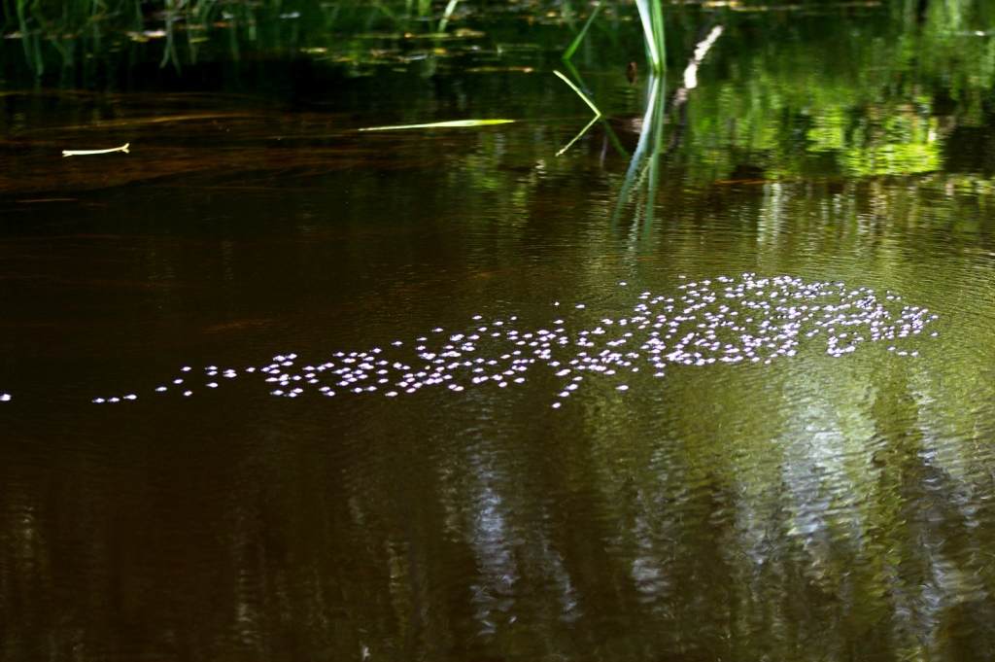

Slide 7
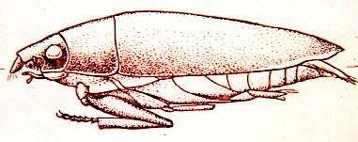
Choice of Study Organism:
Whirligig Beetle (Gyrinidae: Dineutes)

Slide 8
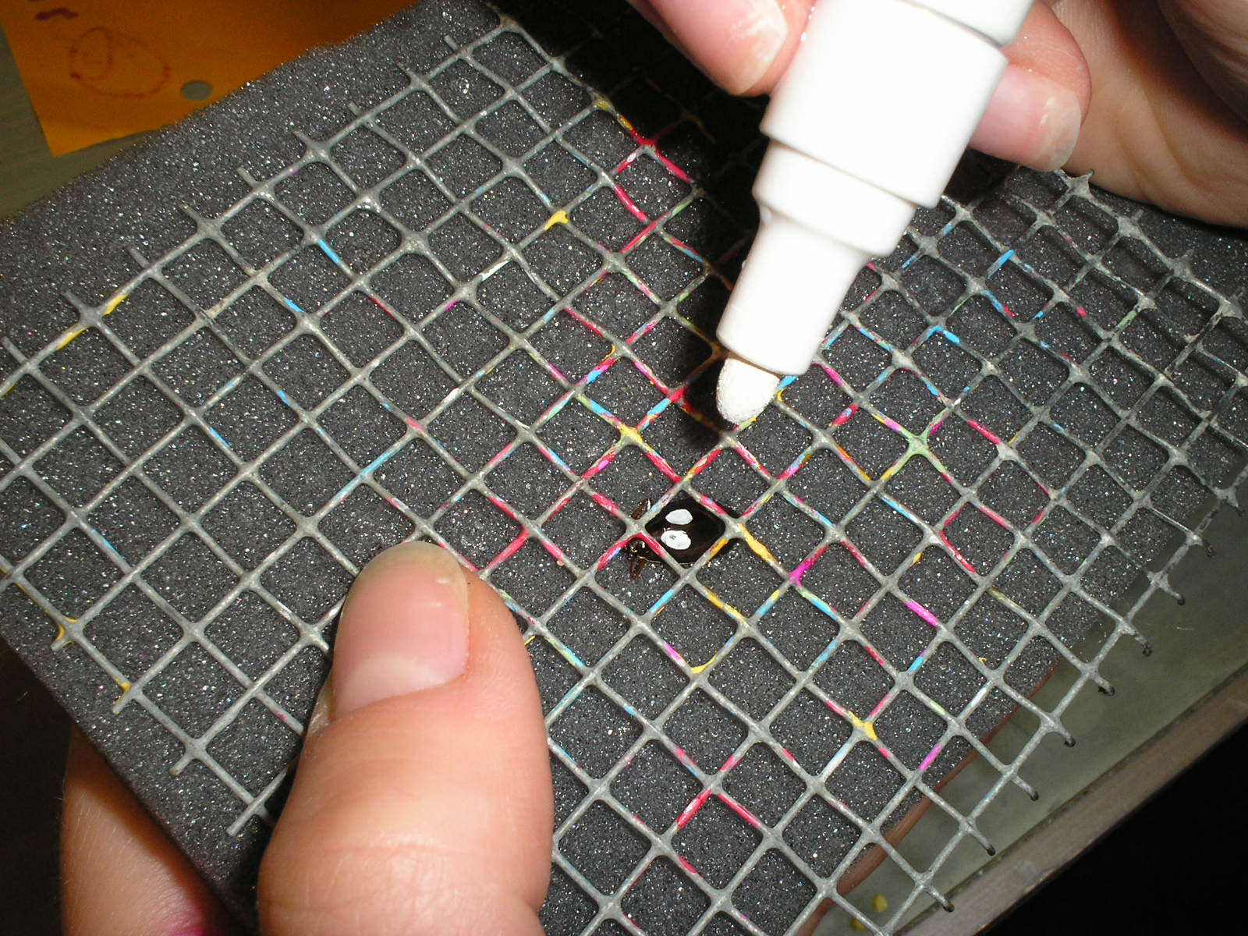

Slide 10
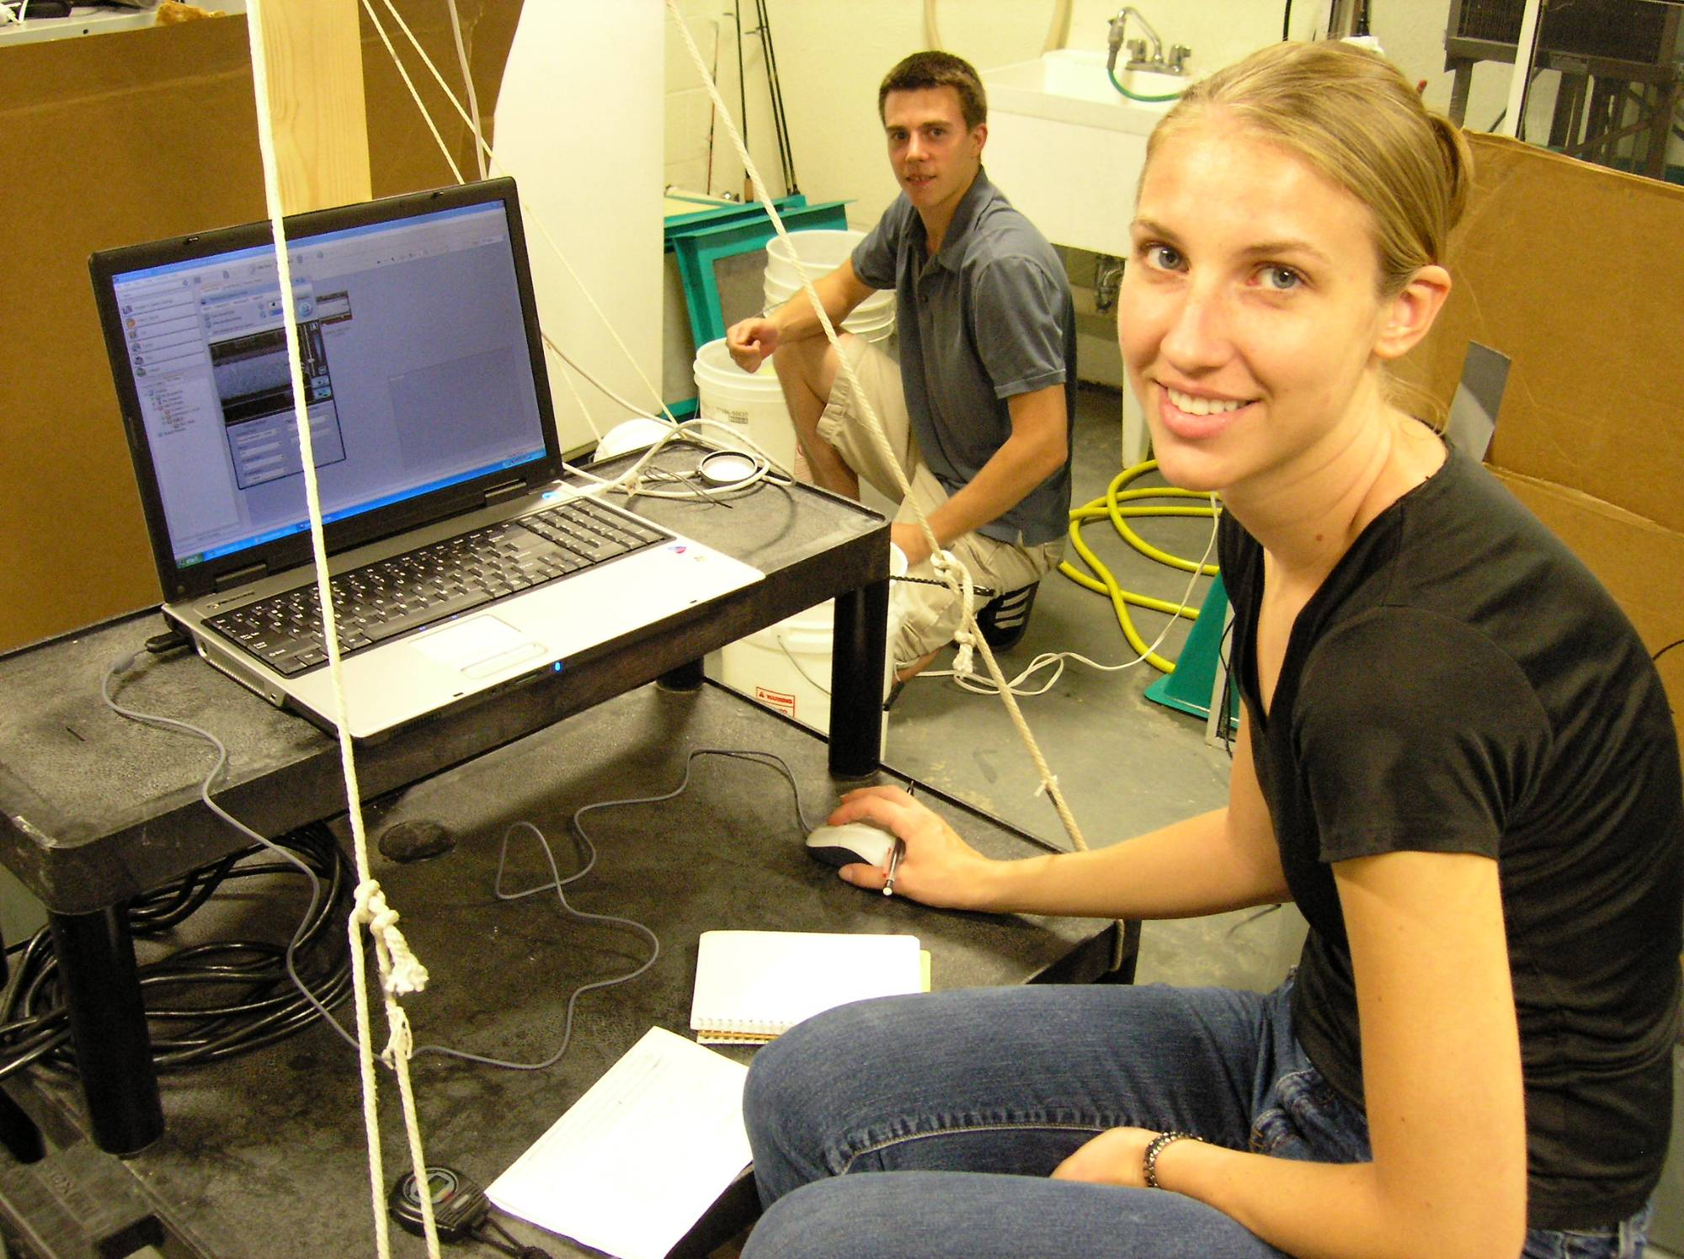

Slide 11
Non Uniform Environments
Food
More at the edge?
Predation
More attacks at edge, front, back?
Drafting
Easier to swim at back?

Slide 12
Foraging Selection Curves: Model Data (Morrell and Romey, 2008)

Slide 13
Predation Selection Curves: Model Data (Morrell and Romey, 2008)

Slide 14
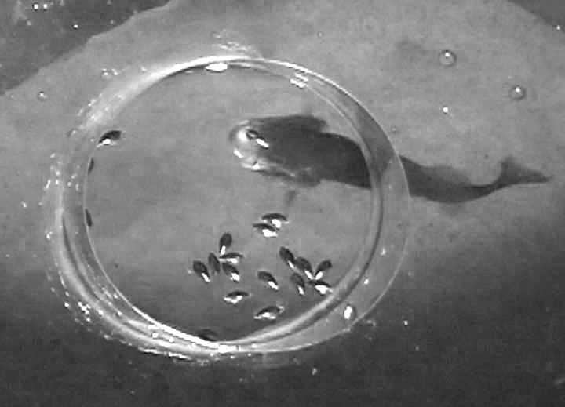
3-D predation on 2-D prey groups
Romey, Walston, and Watt 2008. Behavioral Ecology

Slide 15
Bass Data
Fish Attacks
Center → Edge

Slide 16
Optimization Rules
Simultaneous or temporal
Multiplicative
Weights vary?

Slide 17
Foraging * Predation =
AverageFitness
Center
Edge

Slide 18
But, for a group moving through water:
Foraging + Predator Avoidance ? + Drafting
AverageFitness
Front
Back

Slide 19
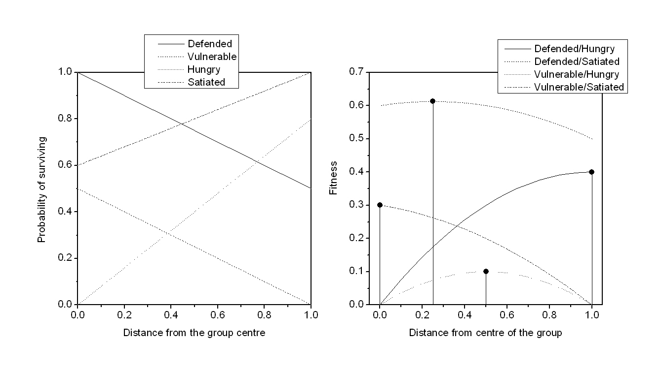

Slide 20
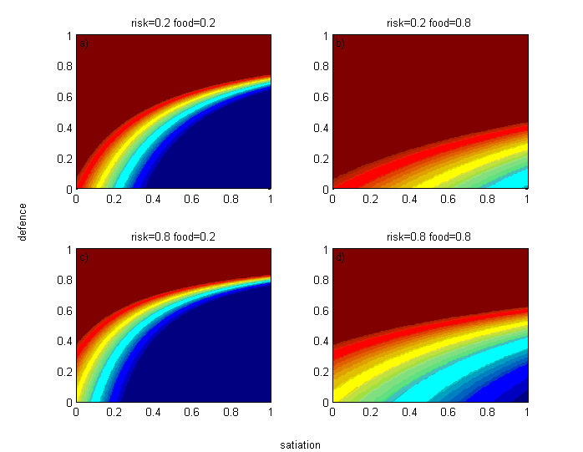
Red = center
Morrell and Romey, 2008, Behavioral Ecology

Slide 21
Whirligig Studies
Systematically vary environment and state variables and determine group position (optimum solution?)
Drafting, Predator
Hunger, Sex, Size

Slide 22
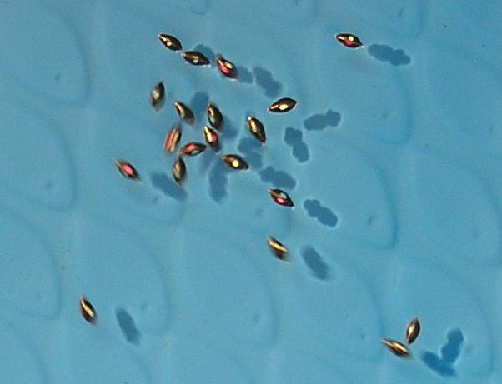

Slide 23
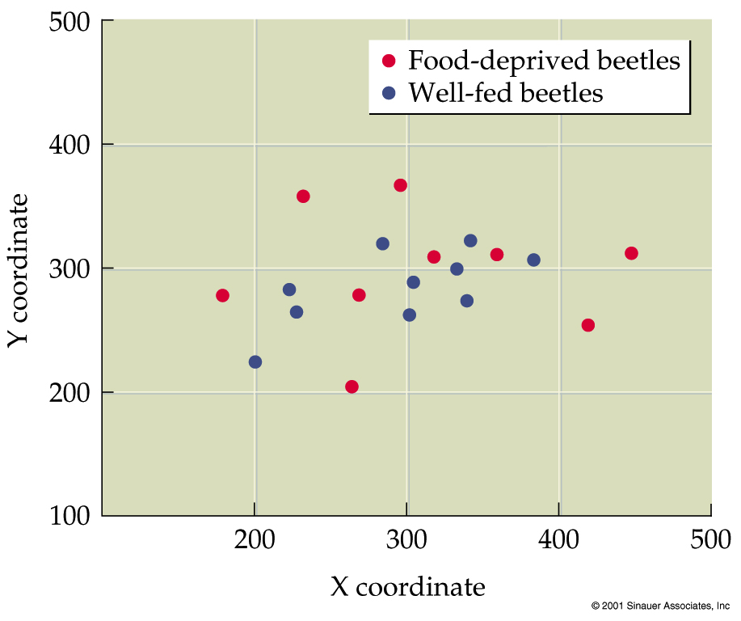
Influence of Hunger on Position? Position and NND
Romey, 1996, Behavioral Ecology and Sociobiology

Slide 24
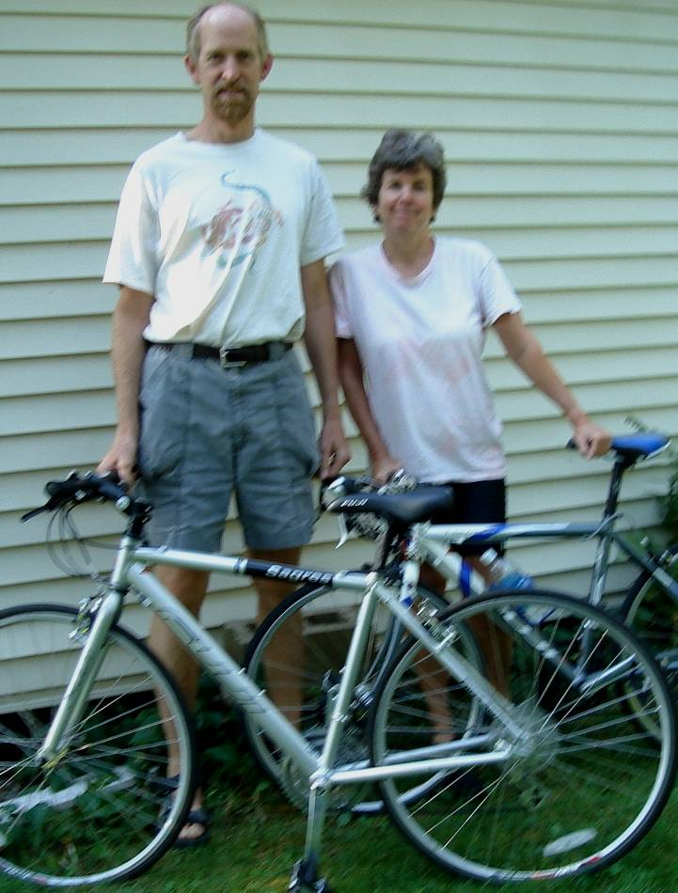
Males and Females have differences which might influence position preferences
Energy Needs
Size
Muscle/Fat →metabolism
Foraging time available
Predator Avoidance
Size
Speed
Defenses

Slide 25
Influence of Sex and Hunger on Position?
Results 2-minutes after simulated attack
Romey and Wallace, 2007, Behavioral Ecology

Slide 26
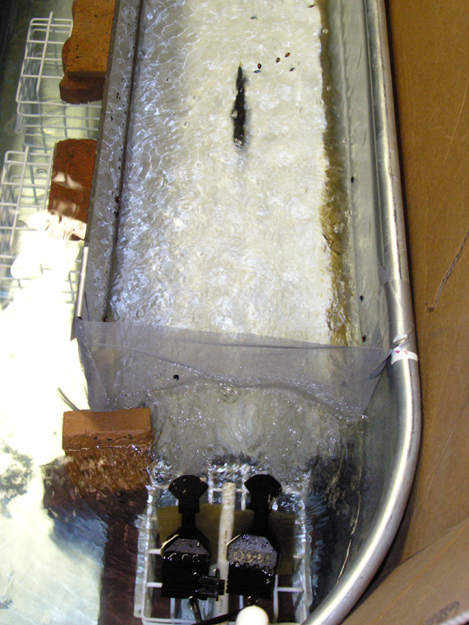
Influence of:
Drafting,
Predator Type,
Sex

Slide 27
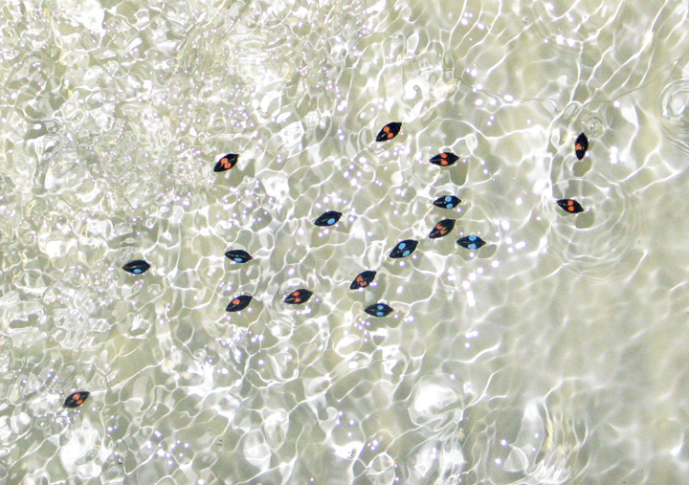

Slide 28
Optimality Predictions: Where do males and females go?

Slide 29
1 cm/s 10 cm/s
Speed * gender interaction
Females to back in slow water (1 cm/s) after bird attack
Satiation also significant
hungry to the front
Romey and Galbraith (2008) Behavioral Ecology

Slide 30
Influence of predator type: (females (white) in back if bird predator, females in front if fish predator)
Romey and LaBuda, in revision

Slide 31
Movement simulation models that incorporate Individual variation
Mixed groups move more slowly and turn more than pure groups
Stochasticity is Not Important
Leadership: how many to turn a group
Group Size may not be that important
(Romey, 1996, Ecological Modelling)

Slide 32
Summary of Previous Research
Non Uniform Environment
Non Uniform Agents
Optimization Rules and Position Preferences

Slide 33
Future: Whirligigs → Engineering Systems?
Movement rules for collision avoidance?
flash expansion needs to be carefully analyzed
How many neighbors to pay attention too?
What rules of thumb suffice to lead individuals to
Avoid predators
Go to the inside/outside, front/back
Variance among individual can be useful in determining group structure
Speed, turning angle,

Slide 34
Engineering Systems → Whirligigs
Whirligig type robots to do controlled experiments to test out what rules they follow
What else?

Slide 35
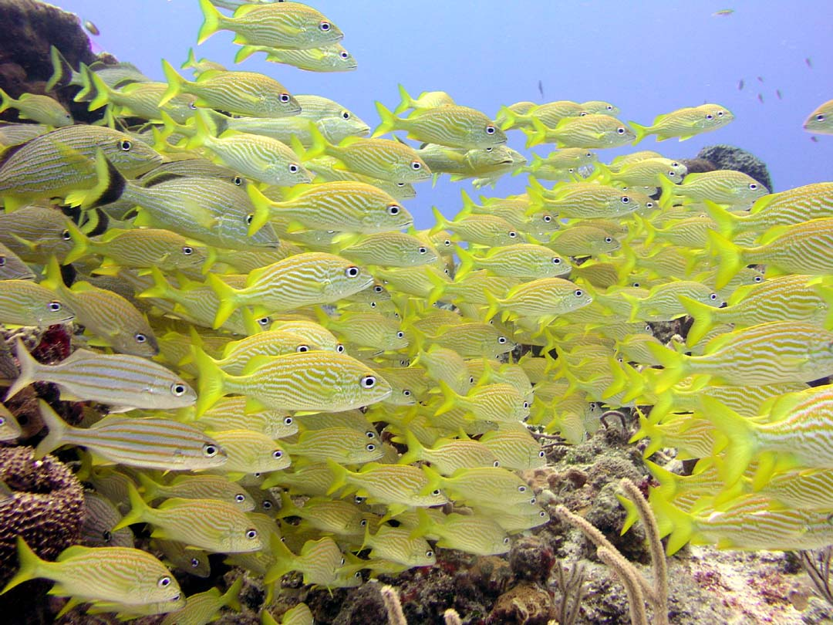
Questions and Ideas?
Contact : Bill Romey
romeywl@potsdam.edu

