Slide 1

CIS 1210 Final Exam
Good luck on the final y'all <3

Slide 2
JEOPARDY BOARD
FINAL JEOPARDY
Big-O & RT Analysis | Divide & Conquer | Graph Traversals | Advanced Graphs | Data Structures | Mystery
$100 | $100 | $100 | $100 | $100 | $100
$200 | $200 | $200 | $200 | $200 | $200
$300 | $300 | $300 | $300 | $300 | $300
$400 | $400 | $400 | $400 | $400 | $400
$500 | $500 | $500 | $500 | $500 | $500

Slide 3

Big-O & RT Analysis - $100 Question
What do these recurrences solve to?
(a) T(n) = T(n/2) + c
(b) T(n) = 2T(n/2) + cn

Slide 4

Big-O & RT Analysis - $100 Answer
(a) Theta(log n)
(b) Theta(n log n)
Notes:
You can apply Simplified Master Theorem here but please know these two recurrences by heart!

Slide 5
Big-O & RT Analysis - $200 Question
What does
T(n) = 2T(n/3) + cn
solve to?

Slide 6
Big-O & RT Analysis - $200 Answer
Theta(n)
Notes:
You could use expansion to solve this mathematically, but the quickest way is to apply Simplified Master Theorem here, where a = 2, b = 3, and k = 1. This is Case 3, so T(n) = Theta(n^k) = Theta(n).

Slide 7
Big-O & RT Analysis - $300 Question
Build-min-heap runs in…
(a) O(n)
(b) Theta(n)
(c) O(n log n)
(d) Theta(n log n)

Slide 8
Big-O & RT Analysis - $300 Answer
(a) O(n)
(b) Theta(n)
(c) O(n log n)
Notes:
Build-min-heap runs in O(n) time, which means it also runs in O(n log n) time. Note that O(n log n) time is a loose/not tight upper bound derived from calling Min-heapify on each of the n nodes, each call which takes O(log n) time. However, since Build-min-heap works from the "bottom up," we can be stricter since each Min-heapify call takes O(h) time, and this analysis (Lecture Notes page 73) yields a runtime of O(n) time. Note that since we will call Min-heapify on about n/2 nodes, we know Build-min-heap also runs in Omega(n) time. Since it runs in both O(n) and Omega(n) time, then we know that it runs in Theta(n) time.

Slide 9
Big-O & RT Analysis - $400 Question
Which pair of algorithms do not have the same worst-case runtime?
(a) Linear search, Select
(b) Randomized QS, Deterministic QS
(c) Binary Search, Euclid's GCD
(d) Mergesort, Insertion Sort

Slide 10
Big-O & RT Analysis - $400 Answer
(d) Mergesort, Insertion Sort
Notes:
(a) Linear search and Select both run in O(n) time
(b) Randomized QS and Deterministic QS both run in worst-case O(n^2) time
(c) Binary search and Euclid's GCD both run in O(log n) time
(d) Mergesort runs in O(n log n) time and Insertion Sort runs in worst case O(n^2) time

Slide 11
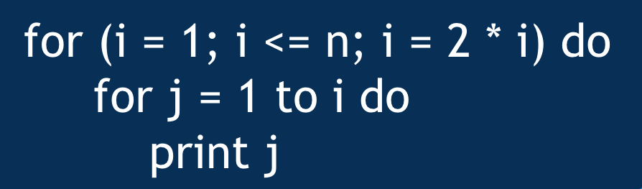
Big-O & RT Analysis - $500 Question
What is the RT of this code snippet?

Slide 12
Big-O & RT Analysis - $500 Answer
Theta(n)
Notes:
This code snippet runs in Theta(n) time. Intuitively, note that when i = n, we perform n work in the inner loop, then when i = n/2, we perform n/2 work in the inner loop, then when i = n/4, we perform n/4 work in the inner loop….and so on until when i = 1, we perform constant work in the inner loop. If we sum these values, the runtime is equal to n + n/2 + n/4 + … + 1, which is a geometric series that converges to Theta(n).
This can also be solved more rigorously/formally with the Summation method -- essentially, we need to find (1) the number of iterations the outer loop runs and (2) the amount of work done in the inner loop during the kth iteration.
(1) Note that the outer loop runs log n times overall since we multiply i by 2 in each iteration.
(2) In the kth iteration of the outer loop, the value of i = 2^k, so in the kth iteration, the inner loop runs 2^k times.
Since in the kth iteration, the inner loop runs 2^k times, and the outer loop runs log n times overall, we can express the runtime of this code snippet as the sum of 2^k where k runs from 0 to log n. This is a geometric series as shown above that converges to Theta(n).

Slide 13
Divide & Conquer - $100 Question
Explain the 3 steps in the Divide & Conquer paradigm and how they apply to Mergesort

Slide 14
Divide & Conquer - $100 Answer
(1) "Divide" array into two subarrays
(2) "Conquer" the problem by recursively sorting both subarrays
(3) "Combine" the sorted subarrays into the sorted array by interleaving the two subarrays with 2 pointers
Notes:
(1) Divide - divide the problem into equivalent subproblems
→ In Mergesort, we divide the array into two subarrays
(2) Conquer - conquer the subproblems by making recursive calls
→ In Mergesort, we "conquer" by recursively sorting each subarray; the base case is a subarray of size 1, which by definition is sorted
(3) Combine - combine the solutions to the subproblems (obtained through recursive calls) into a solution to the original problem
→ In Mergesort, we interleave the two subarrays into one sorted array by using two pointers

Slide 15
Divide & Conquer - $200 Question
Randomized Quicksort runs in expected ____ and worst-case ____ time.

Slide 16
Divide & Conquer - $200 Answer
Expected O(n log n)
Worst-case O(n^2)

Slide 17
Divide & Conquer - $300 Question
Given a sorted input and an O(log n) target runtime, what algorithm should one think of using/modifying?

Slide 18
Divide & Conquer - $300 Answer
Binary search
Click to return to Jeopardy Board
Notes:
This is the approach used in Recitation 3 Question 1 - binary search runs in O(log n) time but requires the input to be sorted, so if we give you these two constraints, try to think of deriving an algorithm just an ~ epsilon ~ away from binary search!

Slide 19
Divide & Conquer - $400 Question
True/False: After calling Select on the ith element, the input array will be partitioned around this element.

Slide 20
Divide & Conquer - $400 Answer
True - Select calls Partition

Slide 21
Divide & Conquer - $500 Question
Is it possible to modify Deterministic QS to run in worst-case O(n log n) time? If so, how?

Slide 22
Divide & Conquer - $500 Answer
Use Select to find the median and use it as the pivot
Notes:
If we use Select to find the median and use it as the pivot, then we can guarantee that after each call to Partition, we will recurse on two subarrays of size n/2, yielding a recurrence of T(n) = 2T(n/2) + cn, which is O(n log n). Note that if we do not use Select to find the median, after a call to Partition, in the worst-case we will just recurse on one subarray of size n - 1, yielding the usual worst-case recurrence of T(n) = T(n - 1) + cn, which is O(n^2). Note that this modification is referred to as something like “Deterministic QS with Select.”

Slide 23
Graph Traversals - $100 Question
In DFS, classify (u, v) based on the color of v when the edge is first explored:
(a) grey
(b) white
(c) black

Slide 24
Graph Traversals - $100 Answer
(a) grey - back edge
(b) white - tree edge
(c) black - forward or cross edge

Slide 25
Graph Traversals - $200 Question
In a DFS traversal on an undirected graph, what types of edges can we have?

Slide 26
Graph Traversals - $200 Answer
(1) Tree edges
(2) Back edges

Slide 27
Graph Traversals - $300 Question
Which of the following can you use BFS to solve, but not DFS?
(a) Cycle detection in an undirected graph
(b) Toposort
(c) Shortest path in a directed, weighted graph
(d) Shortest path in an unweighted graph

Slide 28
Graph Traversals - $300 Answer
(d) Shortest path in an unweighted graph
Notes:
(a) Both BFS and DFS can be used for cycle detection in an undirected graph.
(b) DFS can be used to toposort because of finishing times, so we call it in Tarjan's. However, BFS isn’t quite as robust.
(c) If the graph is weighted, you need to use Dijkstra's to find the shortest paths.
(d) We proved this in Recitation 5! Intuitively, we can use BFS to solve the shortest path problem in an unweighted graph because it explores the graph in layers, so we go wide before we go deep vs. in DFS, where we go deep before we go wide.

Slide 29
Graph Traversals - $400 Question
True/False: The White Path Theorem states that if there is a u → v path and d[u] < d[v], then v is a descendant of u in the DFS forest.

Slide 30
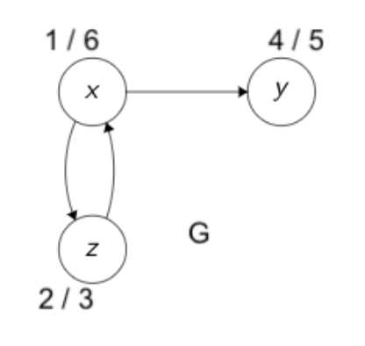
Graph Traversals - $400 Answer
False
Notes:
False, see counterexample. There is a path from z → y and d[z] < d[y], but y will not be a descendant of z in the DFS forest. Note that the White Path Theorem doesn't state this because you know nothing about the colors of the vertices on the path – here, at the time z is discovered, the z → y path goes through x, which is a grey vertex.

Slide 31
Graph Traversals - $500 Question
Which of the following can you use DFS to solve, but not BFS?
(a) Reachability in a directed graph
(b) Toposort
(c) Shortest path in a directed, weighted graph
(d) Shortest path in an unweighted graph

Slide 32
Graph Traversals - $500 Answer
(b) Toposort
Notes:
(a) Both BFS and DFS can be used to determine reachability in a directed graph.
(b) DFS can be used for finding a toposort because we can leverage finishing times. We call it in Tarjan's, but BFS isn't as robust.
(c + d) DFS isn't really applicable for the concept of a shortest path because it goes deep before it goes wide, so it explores as deep as possible in the graph before backtracking.

Slide 33
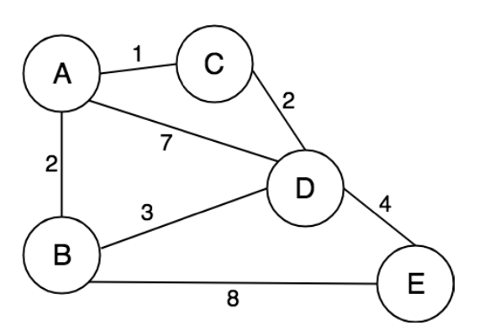
Advanced Graphs - $100 Question
If you ran Dijkstra's starting from A, what is the 4th node popped off the min-heap?

Slide 34
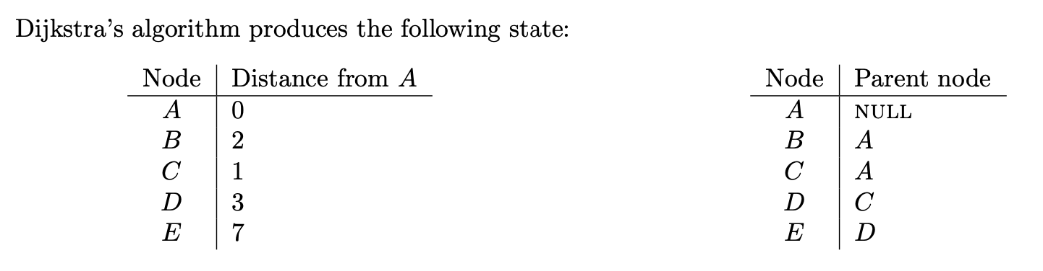
Advanced Graphs - $100 Answer
D

Slide 35
Advanced Graphs - $200 Question
True/False: In a toposort of a DAG, if vertex v comes after vertex u, then there must be a directed edge from u to v.

Slide 36
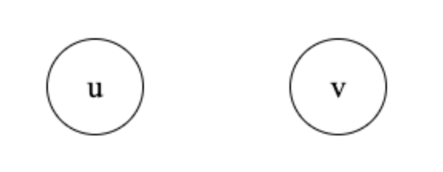
Advanced Graphs - $200 Answer
False - this is a valid toposort!
Notes:
See counterexample

Slide 37
Advanced Graphs - $300 Question
True/False: The second DFS in Kosaraju's algorithm visits the vertices of GSCC in reverse topologically sorted order.

Slide 38
Advanced Graphs - $300 Answer
False - it visits vertices of GSCC in topologically sorted order

Slide 39
Advanced Graphs - $400 Question
Which of these algorithms does not run in
O(m + n) time?
(a) Finding shortest paths in an unweighted graph
(b) Finding SCCs of a directed graph
(c) Finding shortest paths in a weighted graph

Slide 40
Advanced Graphs - $400 Answer
(c) Finding shortest paths in a weighted graph
Notes:
(a) This can be done with BFS.
(b) This can be done with Kosaraju’s.
(c) If the graph is weighted, to solve the shortest paths problem we need to use Dijkstra's algorithm, which runs in O((V + E) log V) time.

Slide 41
Advanced Graphs - $500 Question
Which of the following is/are true?
(a) Dijkstra's works if we multiply weights by positive constant.
(b) Prim's and Kruskal's work on negative edge weights.
(c) Dijkstra's works if we add a constant to each weight.
(d) Reverse-Delete runs in O(m log n) time.

Slide 42
Advanced Graphs - $500 Answer
(a) Dijkstra's works if we multiply weights by positive constant.
(b) Prim's and Kruskal's work on negative edge weights.
Notes:
(a) True. We can think of this transformation as converting from miles to kilometers – the shortest paths are the same regardless of which units we use.
(b) True. Kruskal's will work still because the sorting step still sorts correctly; Prim's will work because when we choose the smallest weighted edge crossing the cut, we will still choose the most negatively weighted one.
(c) False. Dijkstra's does not work if we add a constant to each weight, since we will be adding more weight to longer paths. This means that when we apply this transformation, we are not adding the same weight to each path, so this is not a valid transformation.
(d) False. Reverse-delete runs in O(m^2) time.

Slide 43
Data Structures - $100 Question
Stacks follow the _____ invariant, while queues follow the _____ invariant.

Slide 44
Data Structures - $100 Answer
Stacks - LIFO
Queues - FIFO

Slide 45
Data Structures - $200 Question
A heap must be a…
(a) Binary search tree
(b) Almost complete binary tree
(c) Compressed trie
(d) Sorted array

Slide 46
Data Structures - $200 Answer
(b) Almost complete binary tree
Notes:
The "shape property" of the heap is that it's an almost complete binary tree, so every level is filled except for the last, which is filled from left to right. A heap is different from a BST. In a BST, nodes in the left subtree are less than the root and nodes in the right subtree are greater than the root; in a max-heap for example, the greatest element is at the root, meaning that all of the nodes in its subtrees are less than or equal to it ("heap property"). Note that because of this, a heap does not have to be implemented as a sorted array (see HW5 programming).

Slide 47
Data Structures - $300 Question
What is the space complexity of a compressed trie with s strings? How many leaves does the trie have?

Slide 48
Data Structures - $300 Answer
Nodes: O(s)
Leaves: s
Notes:
There are O(s) nodes, since a compressed trie is "better" than a full binary tree space wise because we guarantee each node has at least 2 children. (The number of leaves in a full binary tree is one more than the number of internal nodes.) There are still s leaves because each root → leaf path represents a string.

Slide 49
Data Structures - $400 Question
True/False: Using a compressed trie improves runtimes for insert, search, delete.

Slide 50
Data Structures - $400 Answer
False
Notes:
It's not necessarily true that a compressed trie improves the runtime of trie operations, since we may still have to compare each character in the target string with the multicharacter labels while traversing through the trie. Note that we use compressed tries because they provide a space, not runtime, advantage. Compressed tries offer a space advantage because we can guarantee that every node has at least two children.

Slide 51
Data Structures - $500 Question
Which of the following is incorrect about open addressing?
(a) UHA assumes m! probe sequences
(b) Linear probing produces m probe sequences
(c) Quadratic probing produces m^2 probe sequences
(d) Double hashing produces m^2 probe sequences

Slide 52
Data Structures - $500 Answer
(c) Quadratic probing produces m^2 sequences
Notes:
Quadratic probing only produces m sequences. Remember that the hash function would be of the form h(k, i) = [h'(k) + c1*i + c2*i^2] mod m, so the initial probe would determine the entire sequence. There are m possible initial probes, since you can probe anywhere in the table, so there are m sequences produced.

Slide 53
Mystery - $100 Question
To efficiently determine if a cycle could exist in Kruskal's, we use the _____ data structure.

Slide 54
Mystery - $100 Answer
Union Find

Slide 55
Mystery - $200 Question
A Huffman tree is a…
(a) Min-heap
(b) Max-heap
(c) Full binary tree
(d) Binary search tree

Slide 56
Mystery - $200 Answer
(c) Full binary tree
Notes:
(a) The Huffman algorithm uses a min-heap to greedily choose the two nodes with minimum frequency at each step, but the Huffman tree outputted is not at all related to a min-heap. Note that you don't even need to use a min-heap to implement the algorithm; a min-heap just improves the runtime.
(b) The Huffman algorithm doesn't ever use a max-heap, and it doesn't output a max-heap.
(c) The Huffman tree is a full binary tree; note that if it weren't, then the tree would not be optimal.
(d) The Huffman tree has no relation to a BST.

Slide 57
Mystery - $300 Question
The discovery and finishing times of a DFS traversal makes a well-formed _____ structure.
Notes:
POTENTIAL FIX WORDING

Slide 58
Mystery - $300 Answer
Parentheses

Slide 59
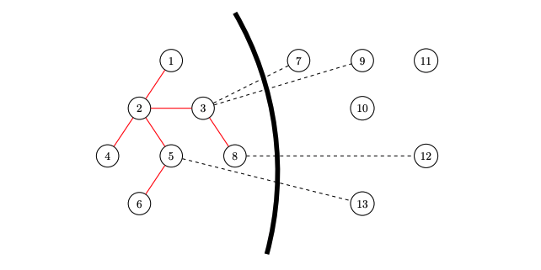
Mystery - $400 Question
Which MST algorithm could this be in the middle of execution?

Slide 60
Mystery - $400 Answer
Prim's Algorithm - demonstrates choosing minimum weight edge crossing cut

Slide 61
Mystery - $500 Question
An operation usually takes O(n) time, but every n operations it takes O(n^2) time. What is its amortized runtime?

Slide 62
Mystery - $500 Answer
O(n)
Notes:
We can estimate the amortized runtime by allowing T(n) to be the total time needed to perform the series of n operations. The amortized runtime of an operation will thus be T(n)/n. Since the operation takes O(n^2) time every n operations but O(n) time otherwise, we can estimate T(n) = n * n + 1 * n^2 = 2n^2. Since we have n operations, the amortized runtime is equal to T(n)/n = O(n).

Slide 63
FINAL
Topic: Hashing

Slide 64
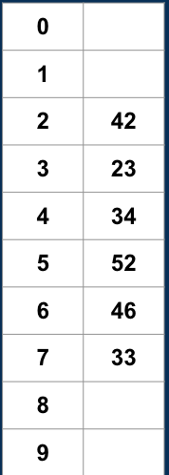
Final Jeopardy Question
How many ways could we have inserted the keys into the table below with linear probing where h(k) = k mod 10? (For example, one way you could’ve inserted the keys is just in the order shown)

Slide 65
Final Jeopardy Answer
30
Case 1 → 4! = 24
Case 2 → 3! = 6
Notes:
First, observe the following:
- 52 has to be inserted after 42, 23, 34.
- 33 has to be inserted after 23, 34, 52, 46.
This essentially boils down to a counting question. Based on the two observations, we have the two cases:
Case 1 - Keys in the set {42, 23, 34, 46} are inserted in any order, followed by 52 and then 33. The first 4 keys could have been inserted in any order since each was inserted in the first slot that would’ve probed. This yields 4! = 24 ways to insert the first 4 keys. After those keys have been inserted, we know that 33 must have been inserted after 52. So, there are 24 ways to insert the keys in this first case.
Case 2 - Keys in the set {42, 23, 34} are inserted in any order, followed by 52, 46, and then 33. The first 3 keys could have been inserted in any order since each was inserted in the first slot we would’ve probed. This yields 3! = 6 ways to insert the first 3 keys. After those keys have been inserted, we must insert 52, then 46, and then 33. Note that we don't consider inserting 46 right after the set of 3 keys because this would have been covered in Case 1 and we would be double counting. So, there are 6 ways to insert the keys in this second case.
This yields 24 + 6 = 30 total ways to insert the keys.

