Slide 1
CIS 320: Introduction to Algorithms
Professor Aaron Roth

Slide 2
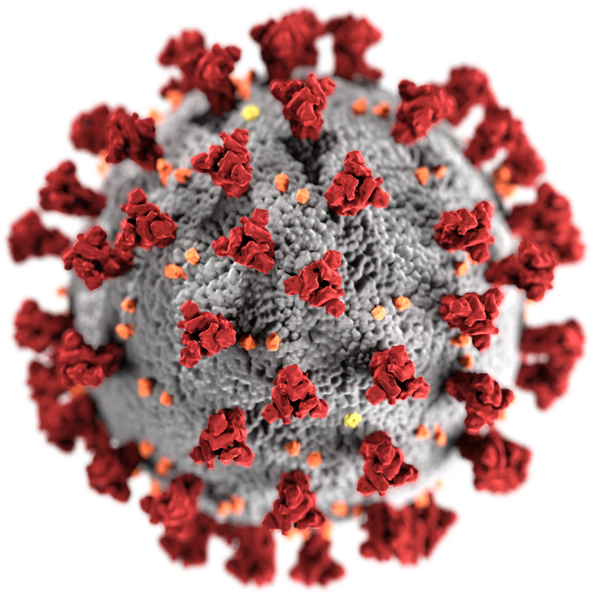
Pandemic! (In case you hadn’t heard)
Aim: Make the class accessible without in-person attendance
Lectures should be recorded
Lecture notes posted to the website
Some office hours on Zoom

Slide 3
Pandemic! (In case you hadn’t heard)
Main reason to attend: Interaction!
Attending lets you ask questions. The fun part!
So, the aim: ask questions all the time if you are here in person.
COVID Etiquette:
Masks on (and worn correctly) all the time
Do not come if sick. (Materials online!)
Distance as possible
Avoid the front row (I’ll aim to keep my mask on, but since I’m lecturing, avoiding the front is prudent)

Slide 4
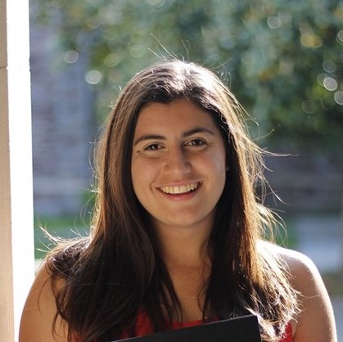
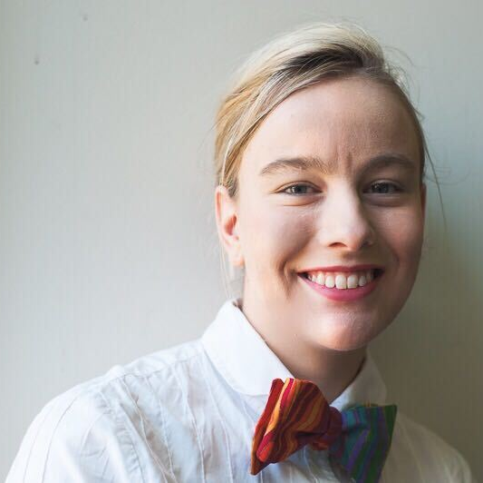
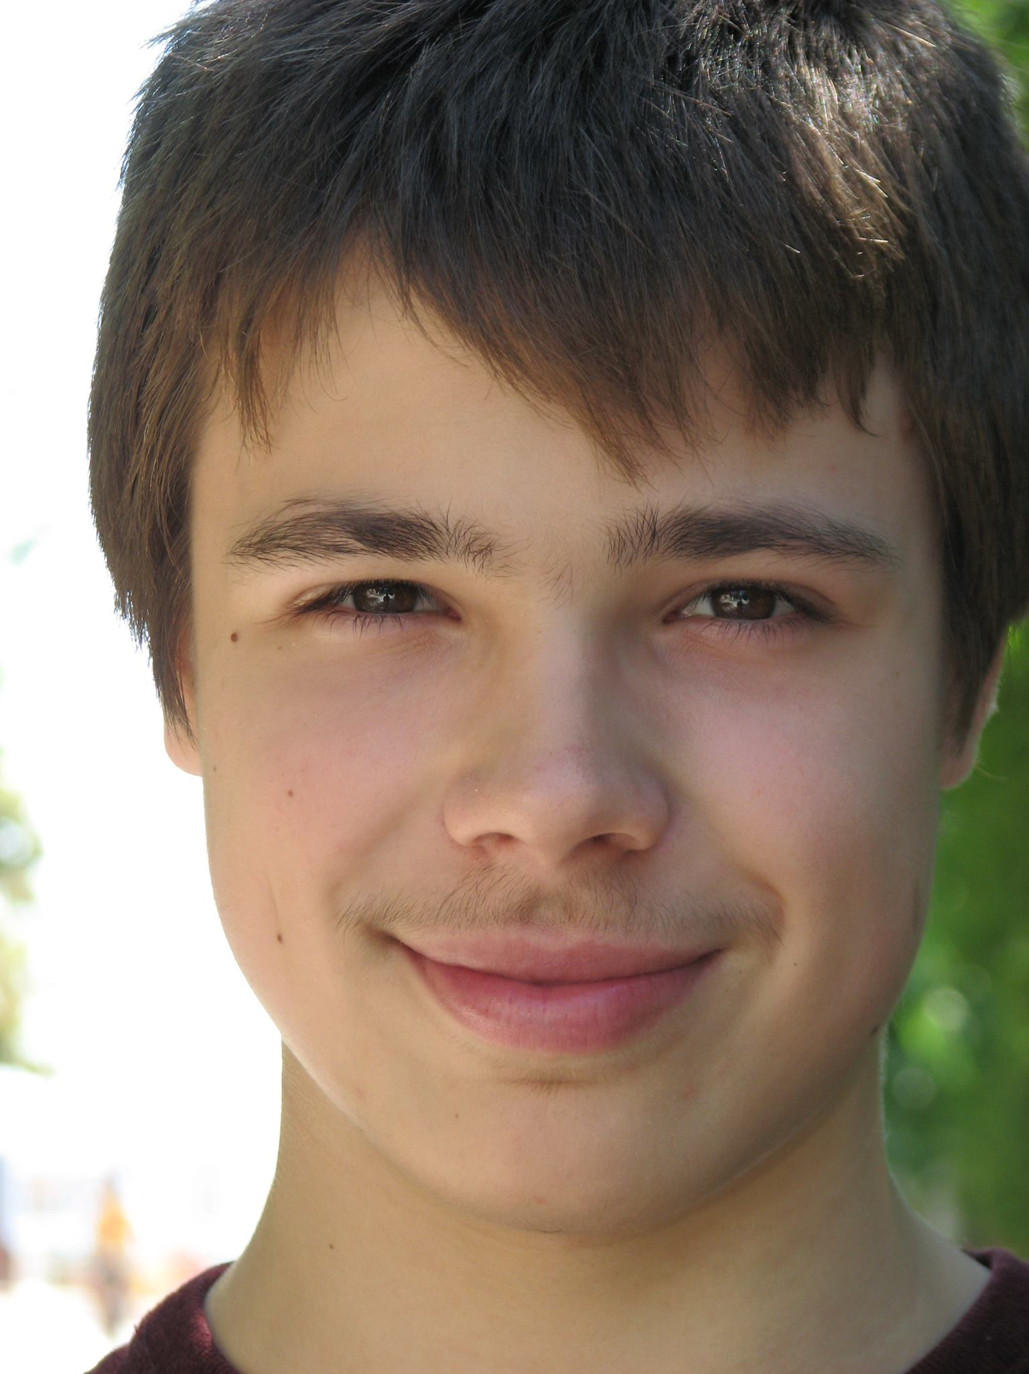
Course Staff Professor and Head TAs
Professor: Aaron Roth
Head TAs:
Natalie Collina Ira Globus-Harris Georgy Noarov
(She/Her) (They/Them) (He/Him)

Slide 5
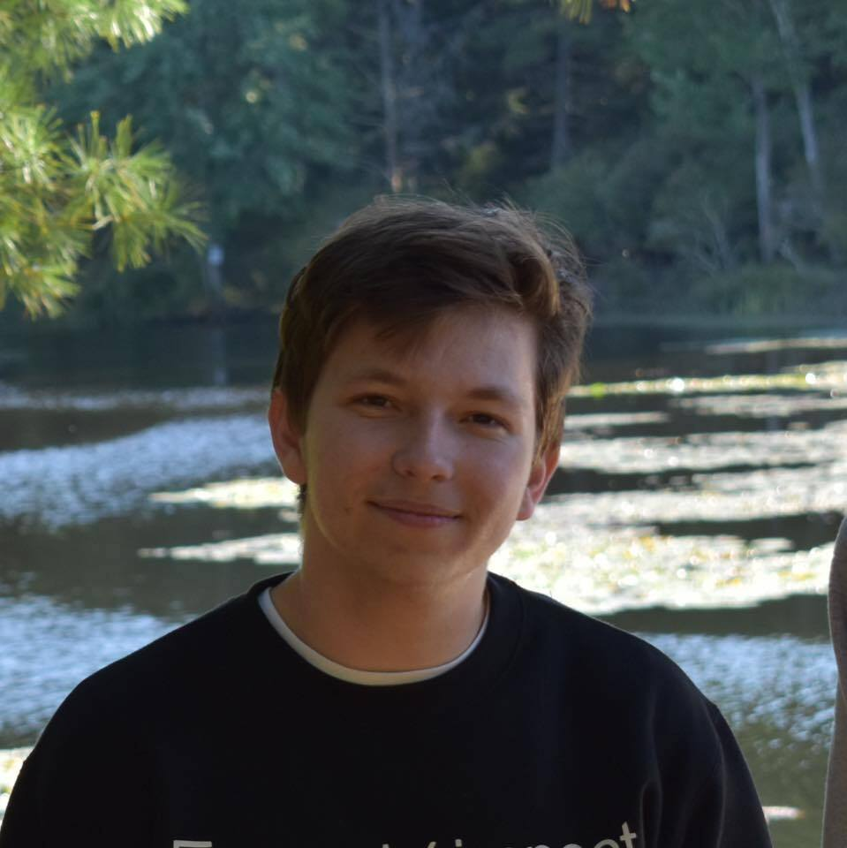
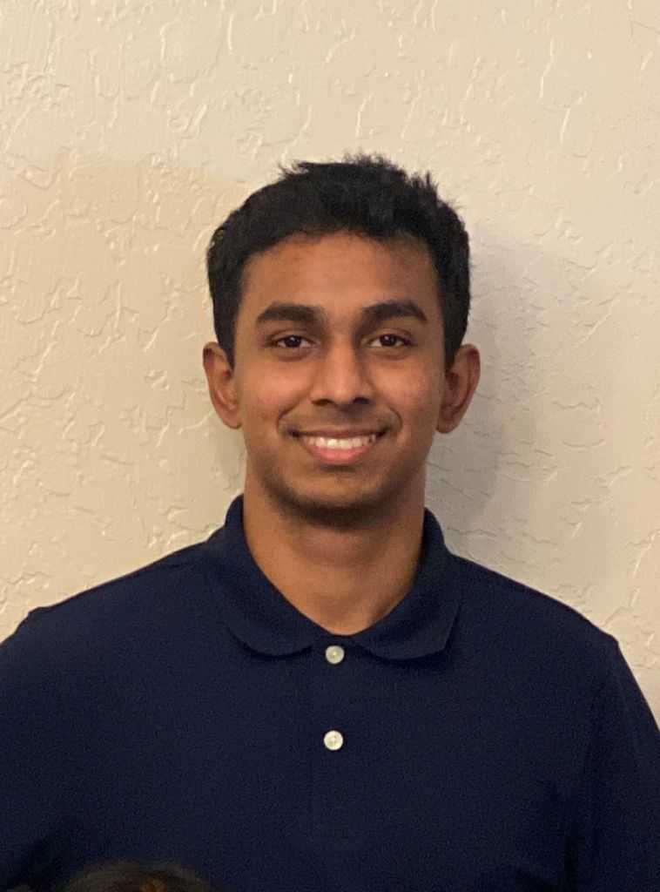
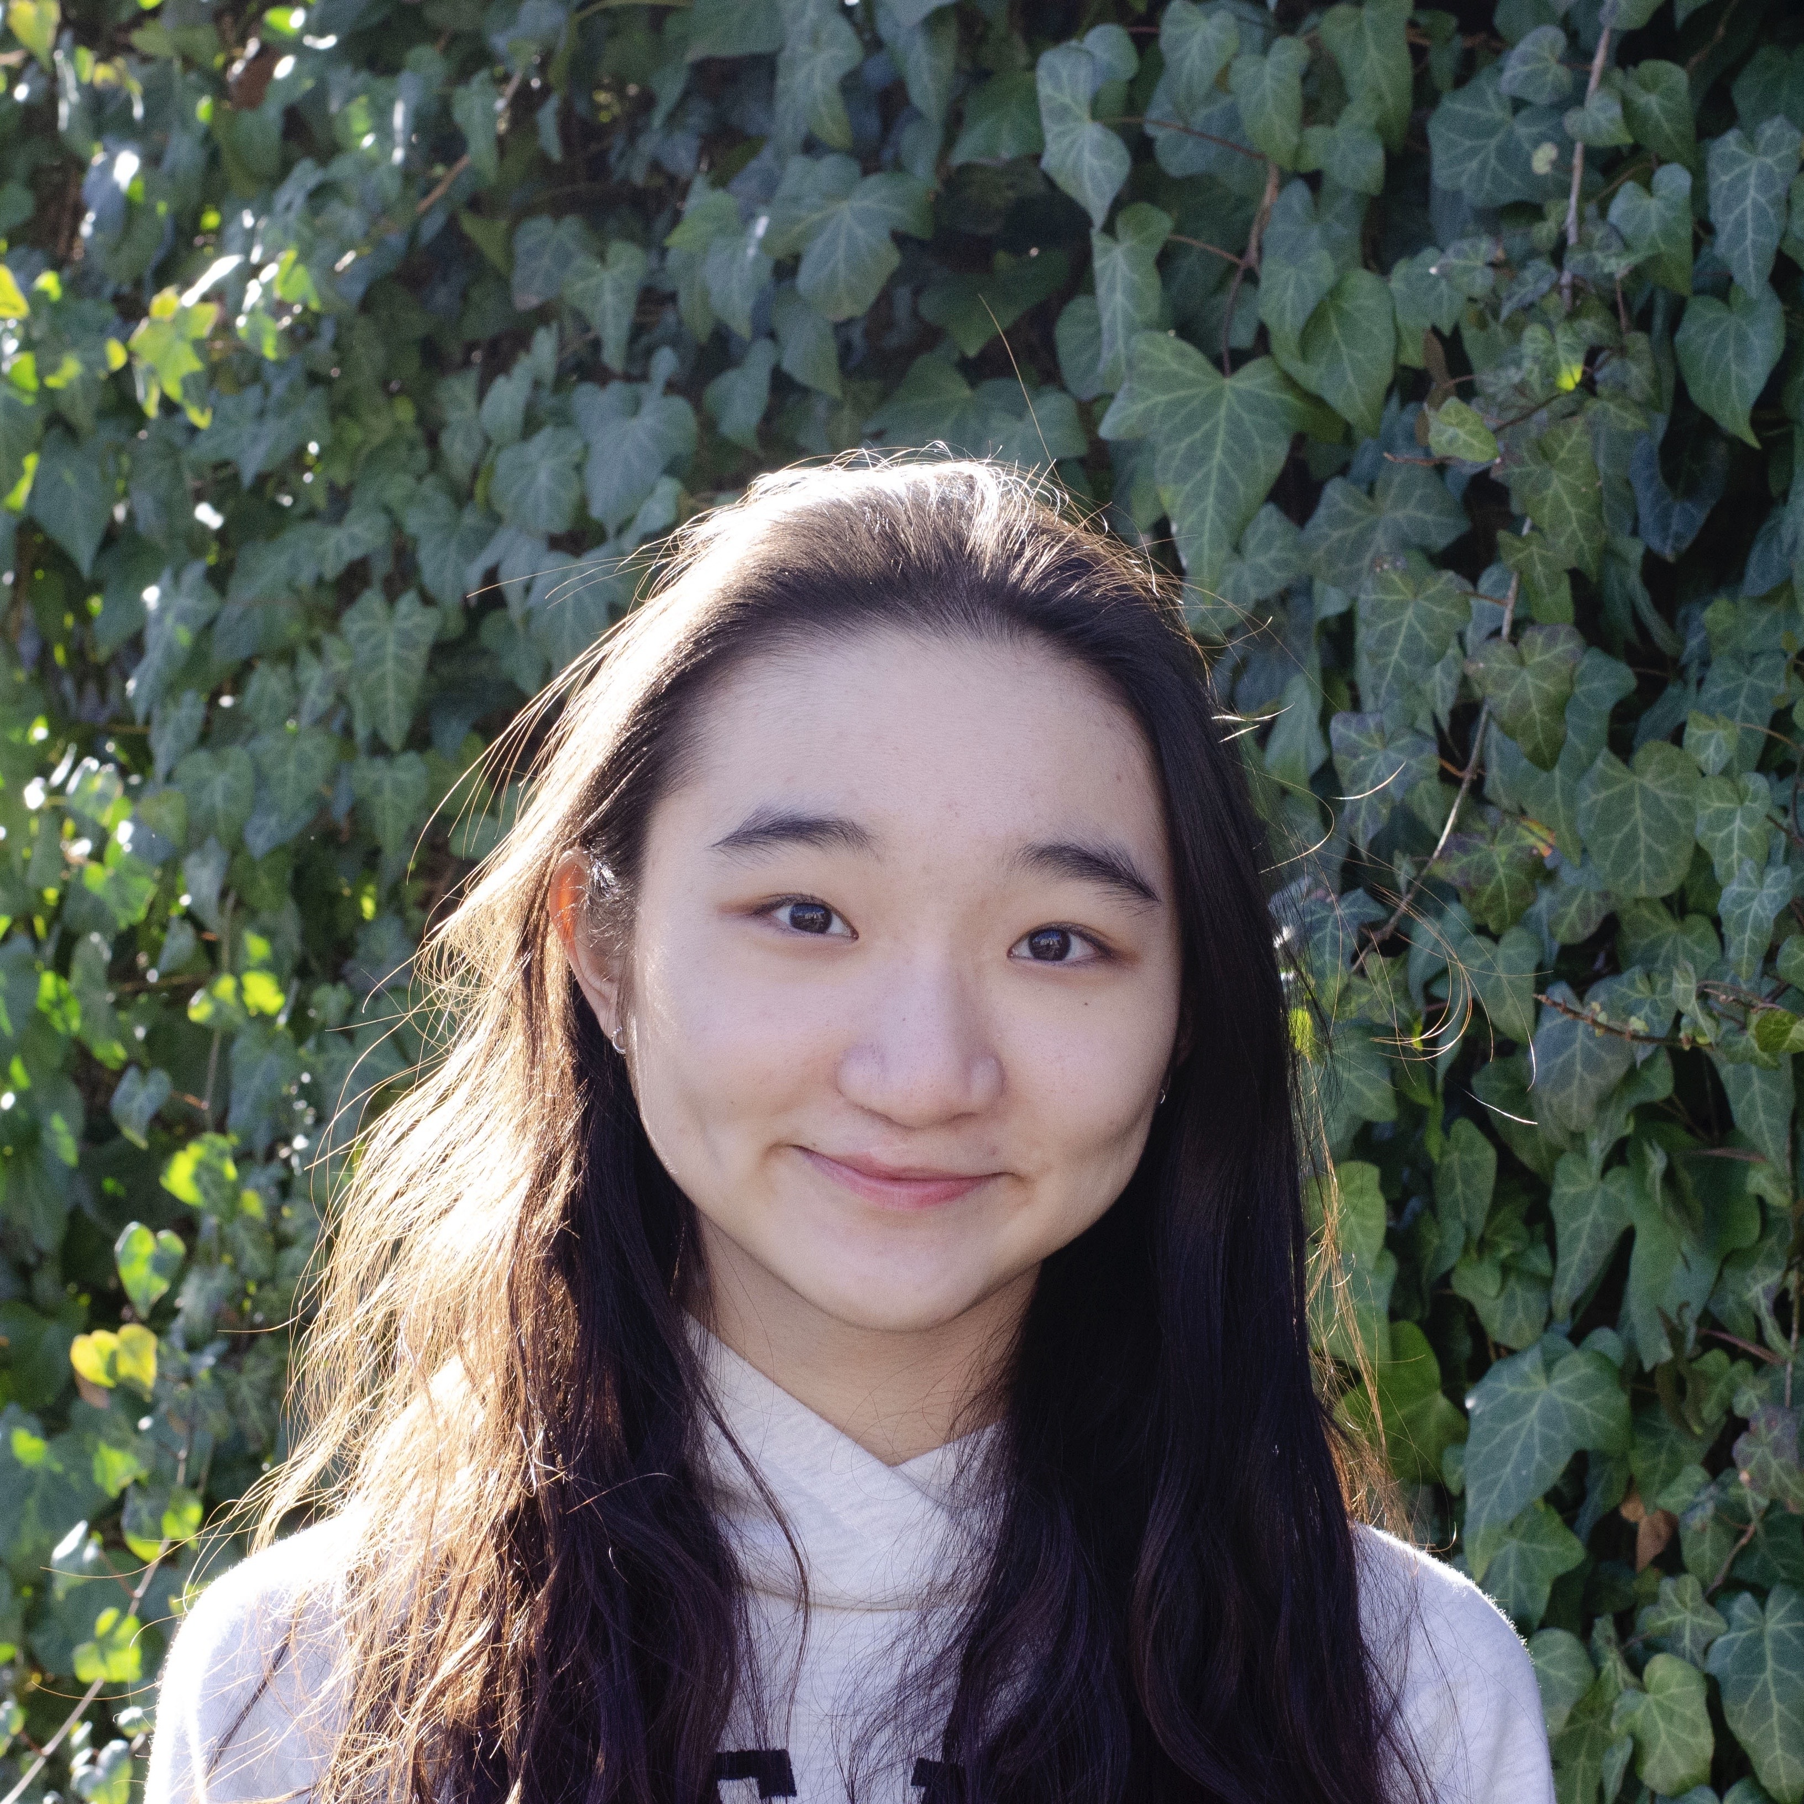
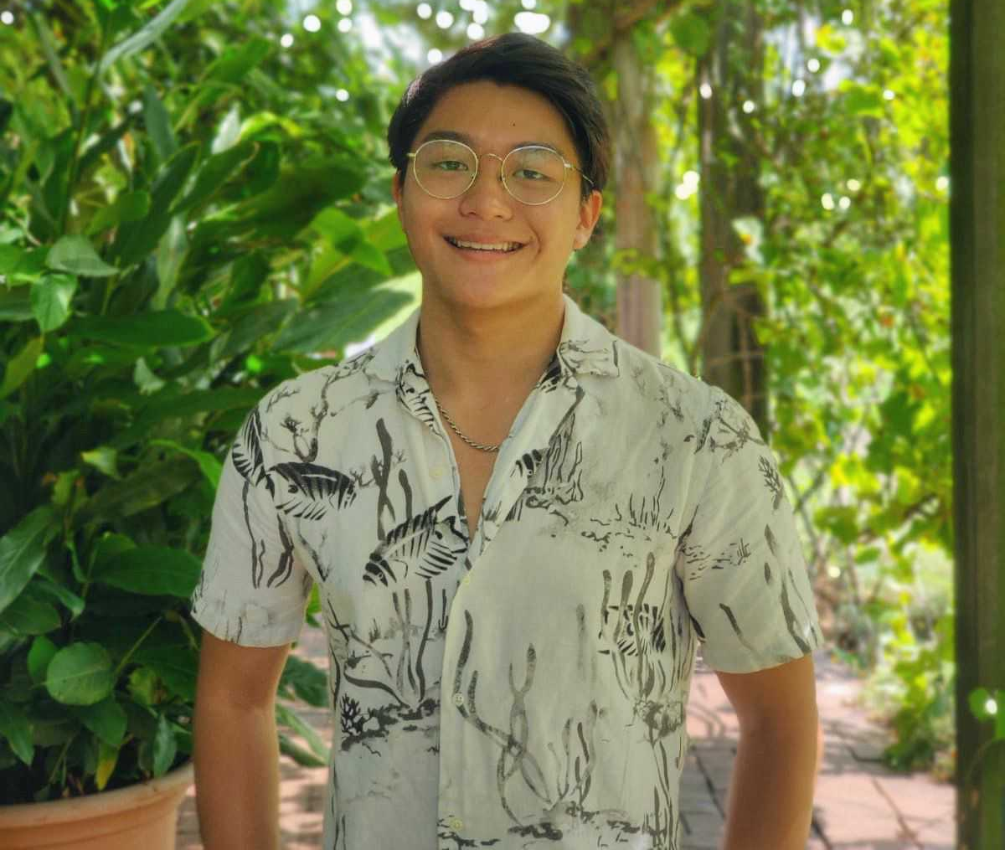
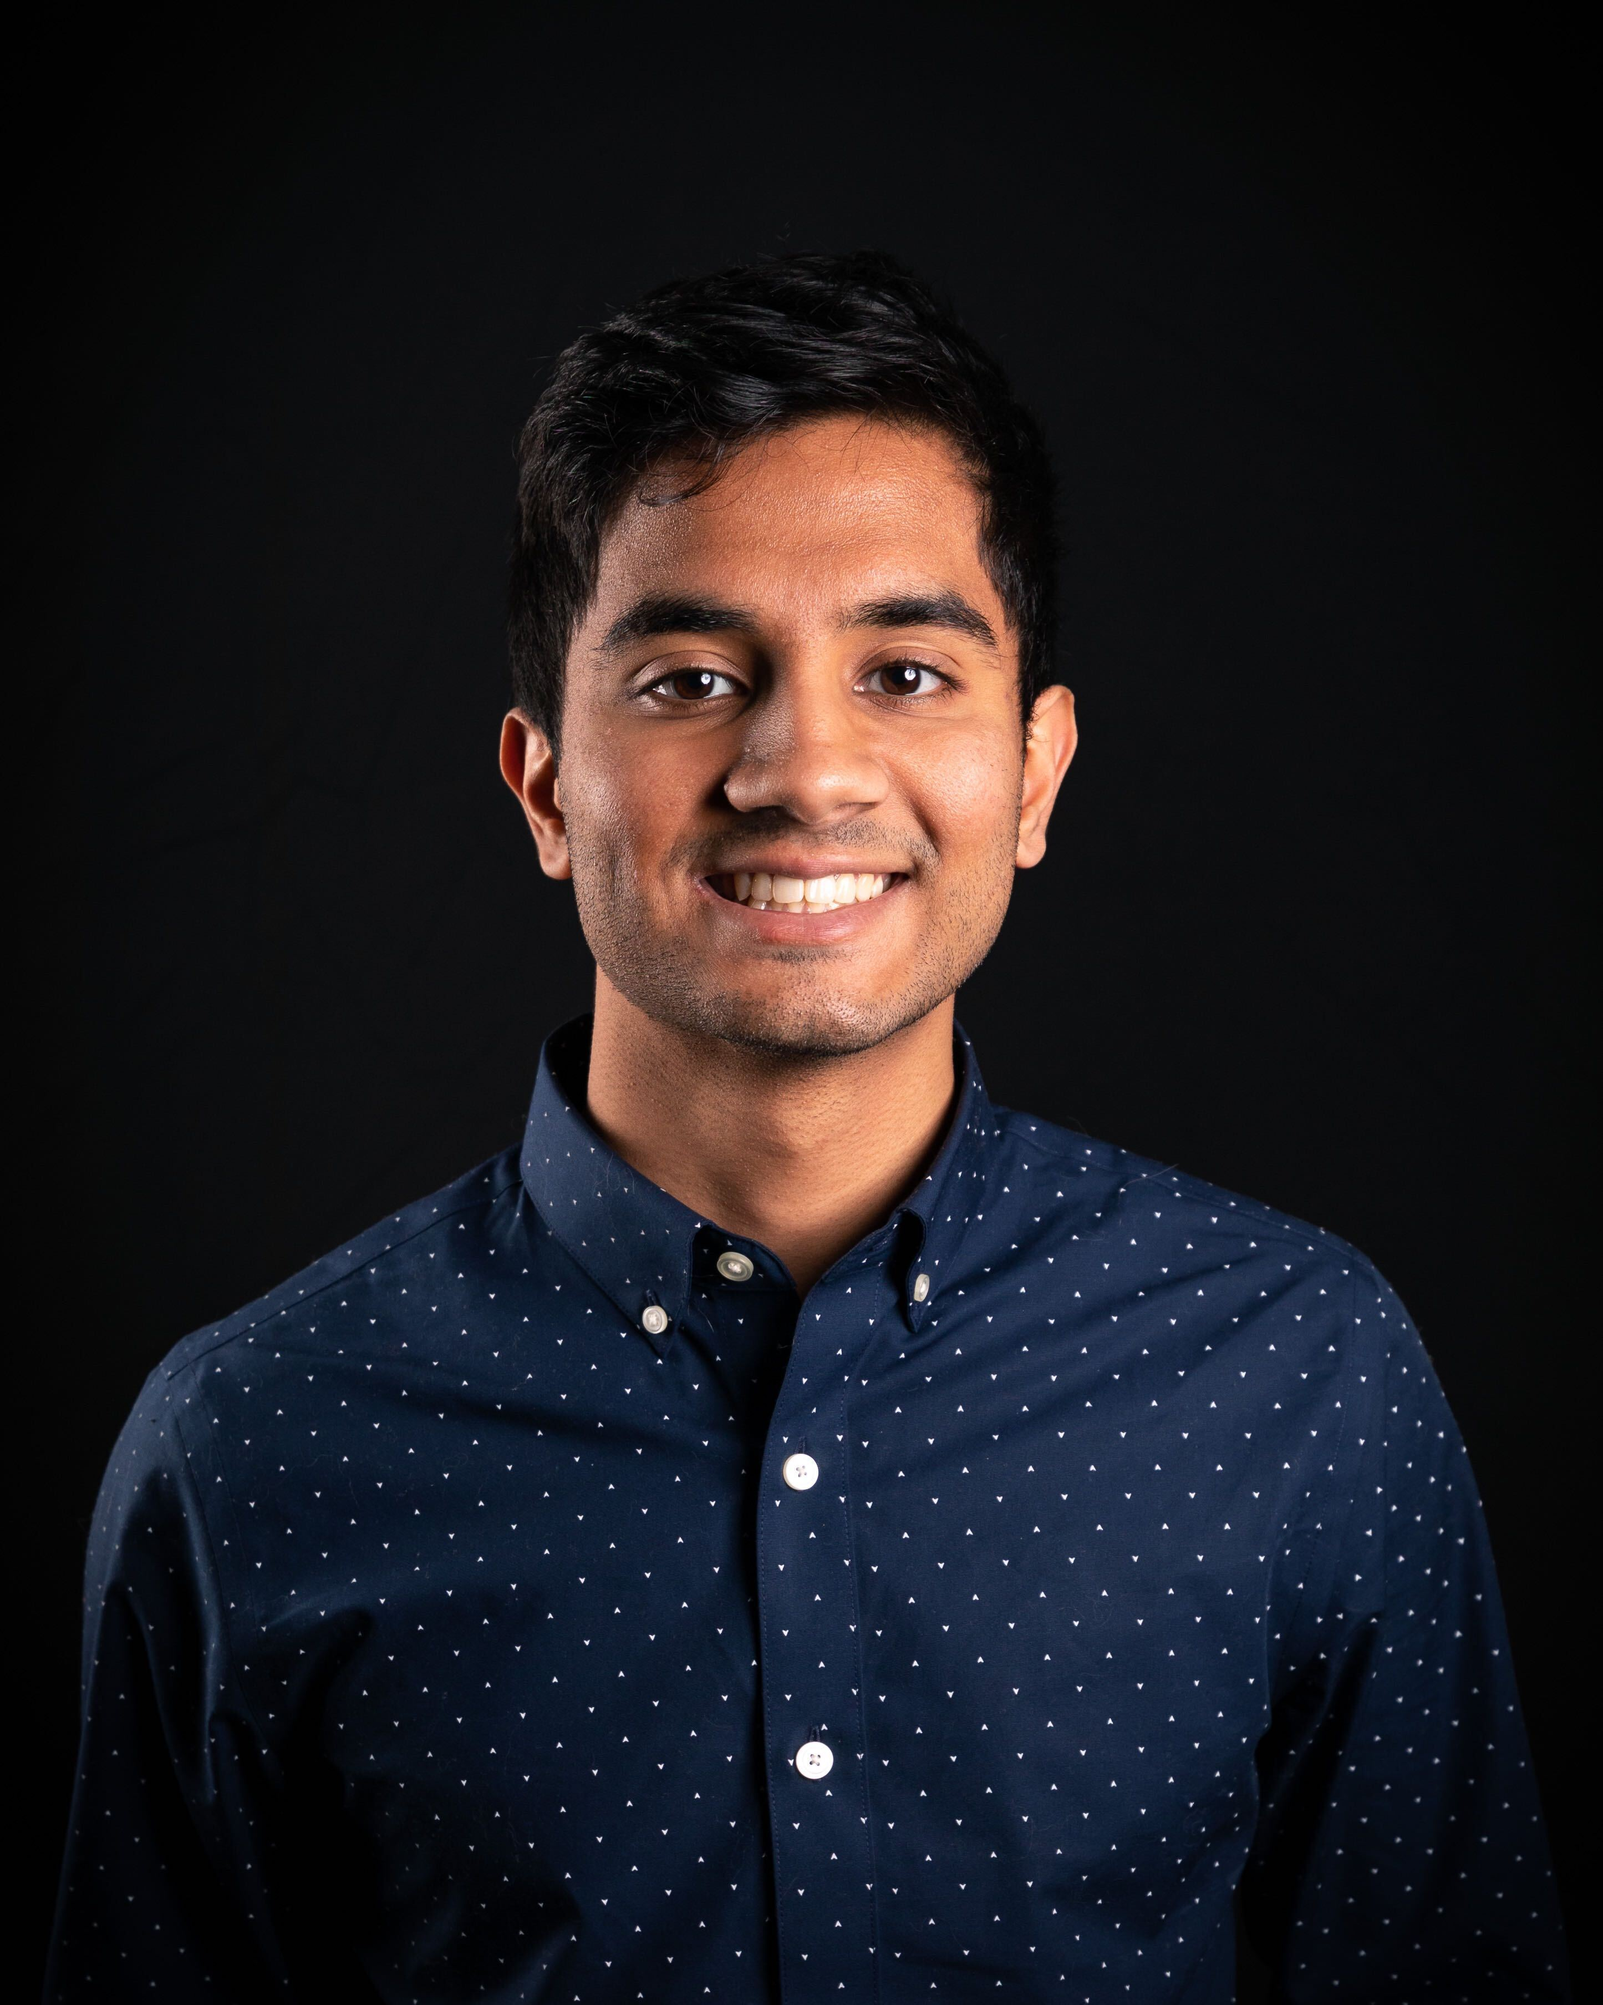
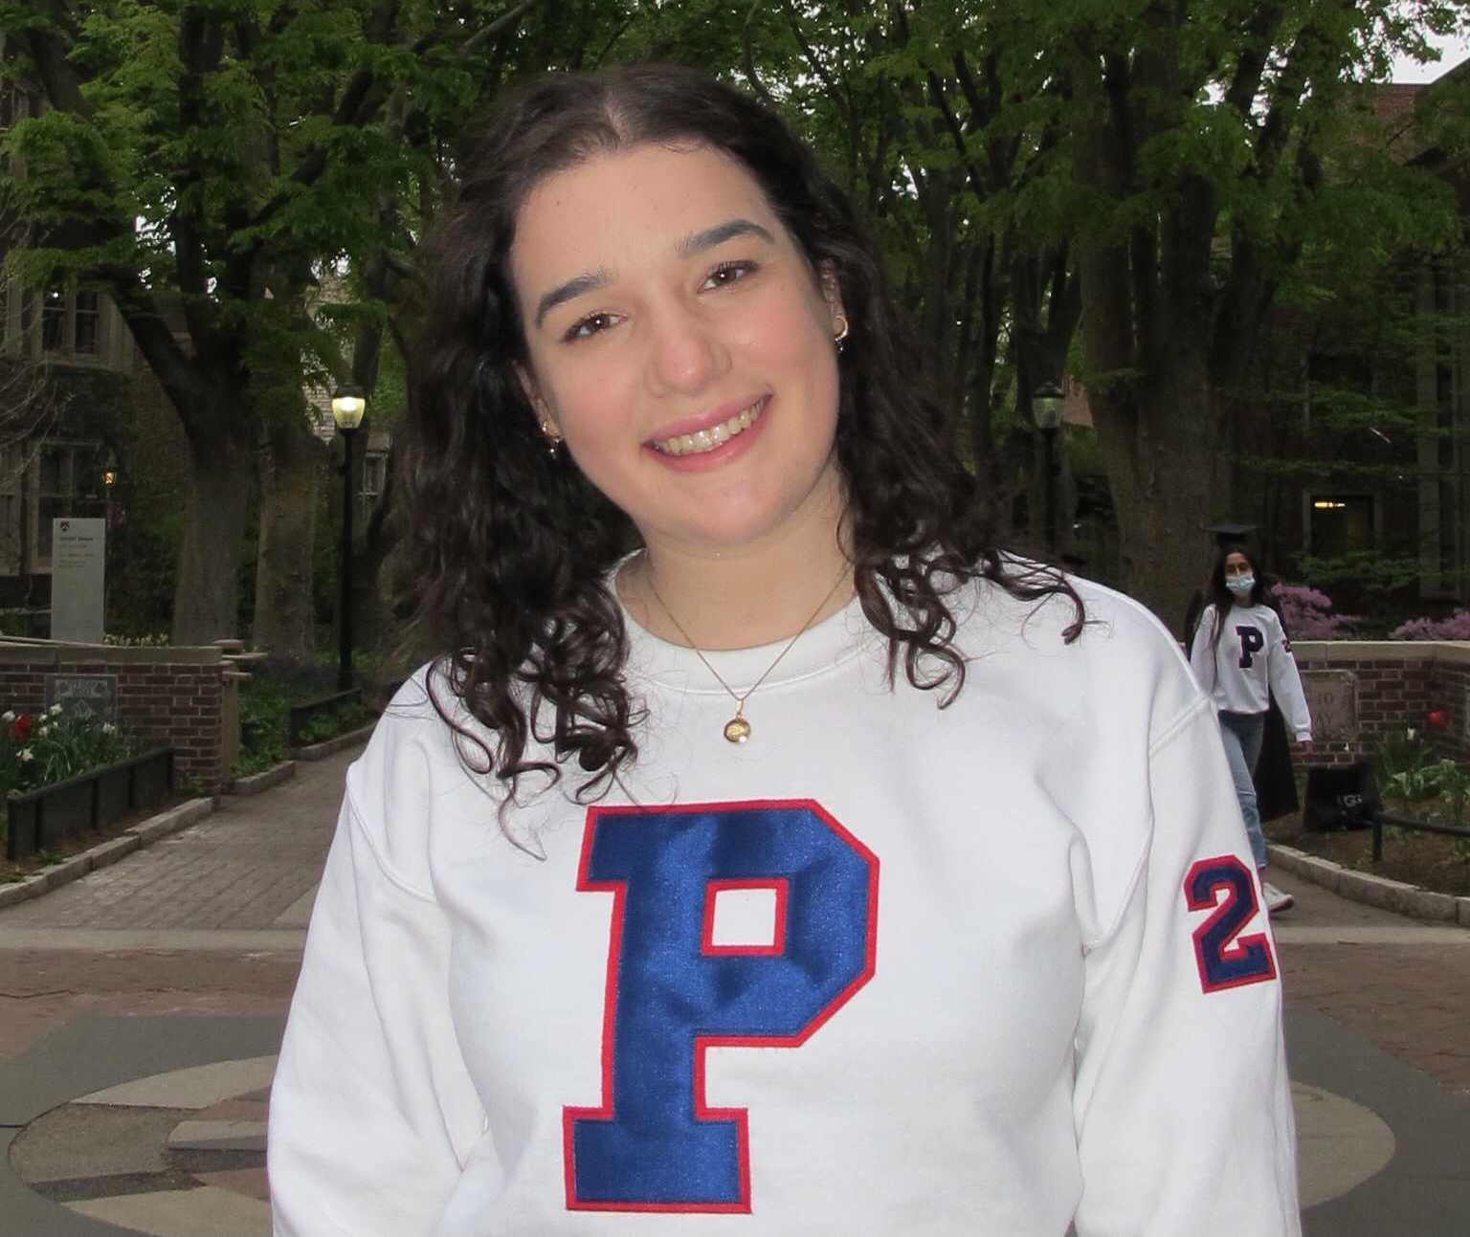
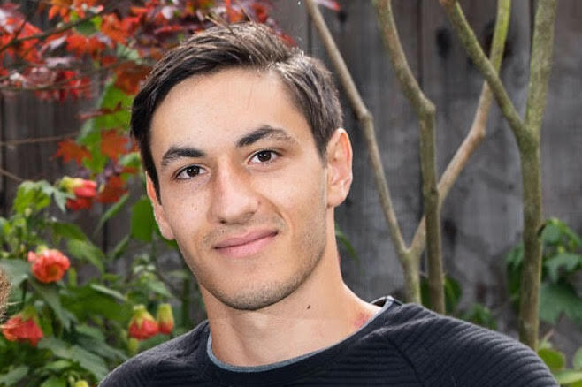
Course Staff TAs
Jared Asch (he/him)
Arnav Aggarwal (he/him)
Amithab Arumugam (he/him)
Cindy Jiang (she/her)
Alexander Go (he/him)
Olivia Gottlieb (she/her)
Colin Hosking (he/him)
Adarsh Rao (he/him)
Saurabh Shah (he/him)
Alexandra Tanner (she/her)
Adam Weidman (he/him)

Slide 6
Resources
The Course Website: https://www.seas.upenn.edu/~cis320/
Lecture notes, problem sets
Canvas
Recordings of Lectures
Piazza
Discussion, office hours schedule
Gradescope
Turning in assignments and viewing grades
Sign up for these now if you are not already.

Slide 7
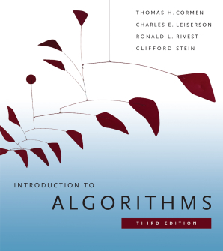
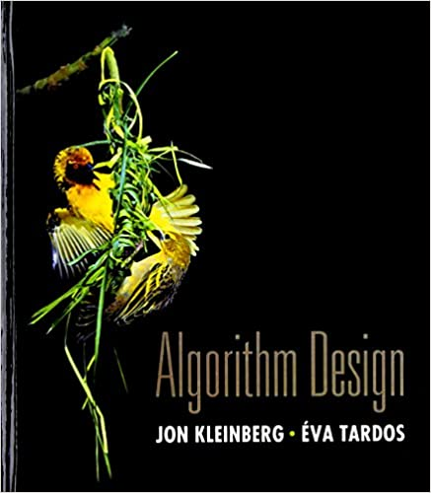
Book
There is no required textbook, and the lecture notes will be self contained.
But many of the topics we are covering are well covered in standard algorithms textbooks; some lectures are adapted from Kleinberg and Tardos.

Slide 8
This will be a mathematical class
No coding; analyzing algorithms as mathematical objects.
Assumed: Mathematical maturity, familiarity with asymptotic notation and analysis, breadth first search, depth first search, data structures, etc.
You should have taken (at least) CIS 120, 160, 262.
Evaluation based on bi-weekly problemsets and exams.

Slide 9
Evaluation
Problem Sets (45%)
6 Problem Sets, every two weeks, due on Wednesdays.
Midterm Exams (30%)
Two midterm exams, worth 15% each. (Oct. 11 and Nov. 22)
Final Exam (20%)
During Finals period at our scheduled time.
Participation (5%)
Regular use of Piazza (asking and answering questions) gets 100% here.

Slide 10
Policy on Late Assignments/Missed Exams
Flexible Late Policy:
Assignments due at the start of class on Wednesdays (3:30 ET).
20% automatically deducted each day late (e.g. if you turn it in by 2:29 on Thursday, your score is multiplied by 0.8).
Lowest Assignment Grade Dropped. (Pset score is average of best 5 assignments)
Strict Exception Policy:
Because of flexibility built into the grading policy, we will grant personal exceptions to the policy rarely (e.g. serious illness)

Slide 11
Collaboration Policy
Collaboration on problem solving is how you learn!
So feel free to work with others on problemsets. But:
Everyone must write up their own solutions independently
Everyone must list their collaborators at the top of their submission
4 collaborators maximum (5 including you)
Do not cheat.
No looking up solutions on the internet, copying from classmates, etc.
If TAs find incidents we’ll refer them directly to the Office of Student Conduct. The result can range from getting a failing grade on the assignment, to getting a failing grade in the course, to expulsion in the case of repeated incidents.

Slide 12
Stuff We’ll Learn!
Computers are fast and getting faster…
But clever algorithm design can be worth decades/eons of hardware improvements.
Asymptotics vs. n | 1000 | 2000 | 3000 | 4000 | 5000 | 6000
$$O(n)$$ | 1000 | 2000 | 3000 | 4000 | 5000 | 6000
$$O(n\log{n})$$ | 9965 | 21931 | 34652 | 47863 | 61438 | 75304
$$O(n^{2})$$ | 1000000 | 4000000 | 9000000 | 16000000 | 25000000 | 36000000
$$O(2^{n})$$ | $$≈{10}^{301}$$ | $$≈{1.1⋅10}^{602}$$ | $$≈1.2⋅{10}^{903}$$ | $$≈1.3⋅{10}^{1204}$$ | $$≈1.4⋅{10}^{1505}$$ | $$≈1.5⋅{10}^{1806}$$

Slide 13
We can often achieve these improvements vs. the “naïve” algorithm
Sorting
Naïve $O\left(n^{2}\right)$
Optimal $O\left(n\log{n}\right)$
Median Finding
Naïve $O(n^{2})$ (or $O(n\log{n)}$ once you learn sorting)
Optimal $O(n)$
Integer Multiplication
Naïve (Elementary School Method) $O(n^{2}$)
Optimal $O(n\log{n})$
Max Value Interval Scheduling
Naïve $O(2^{n})$
Optimal $O(n)$

Slide 14
An Arsenal of Techniques: Discrete Optimization
Divide and Conquer
Figure out how to quickly stitch together two (or more) optimal solutions to sub-problems. Recursively solve the sub-problems.
“Dynamic Programming” (actually Divide and Conquer++)
The naïve recursion might have exponential size, but if we have only polynomially many distinct sub-problems, we can just cache the solutions to avoid wasted effort.
Greedy Algorithms
Make myopic choices. Very fast. Works when optimal solutions satisfy a certain “exchange” property.

Slide 15
An Arsenal of Techniques: Continuous Optimization
Gradient Descent
For optimizing continuous, differential functions. Quickly converges to the optimal solution for convex problems, and to stationary points for nonconvex problems.
Multiplicative Weights
For online optimization --- obtains guarantees for adversarial sequences of loss functions
Linear Programming
Powerful framework for optimizing linear functions subject to linear constraints. Closely related to online optimization and zero sum games.

Slide 16
Lower Bounds and Hardness
Sometimes we can find a solution to a problem
An $O(n\log{n})$ algorithm for sorting
An $O(n⋅W)$ algorithm for Knapsack
Maybe if we were more clever, we could find a better one…
Or maybe we could prove that there is no better one!
All comparison based sorting methods require $Ω\left(n\log{n}\right)$ comparisons
Knapsack is $NP$-Complete.

Slide 17
NP Completeness
“NP” represents the (enormous) class of problems whose solutions can be verified in polynomial time.
Verification seems much easier than problem solving.
NP-Complete problems are problems in NP such that if you could solve them in polynomial time, you could solve all problems in NP in polynomial time.
An algorithmic statement! You can use an algorithm for an NP-complete problem as a subroutine in an otherwise efficient algorithm for all the rest.
Lots of effort has gone into solving many of these problems, so it is thought to be impossible --- i.e. conjecture: $P≠NP$.
So: showing something is NP complete is strong evidence there is no polynomial time algorithm for it.

Slide 18
Getting Around Intractability: Approximation
If a problem (e.g. Knapsack) is NP-complete, it likely has no polynomial time algorithm for exactly solving it.
But sometimes approximately optimal solutions are good enough, and can be found quickly.

Slide 19
Background and Setup
Algorithms can be reasoned about formally
You saw e.g. Turing Machines in CIS 262
Can come up with similar formal models for RAM machines, etc.
But we’ll mostly aim at clarity rather than formalism when given the choice.
We’ll describe algorithms in pseudocode
Lets us focus on the algorithmic ideas.

Slide 20
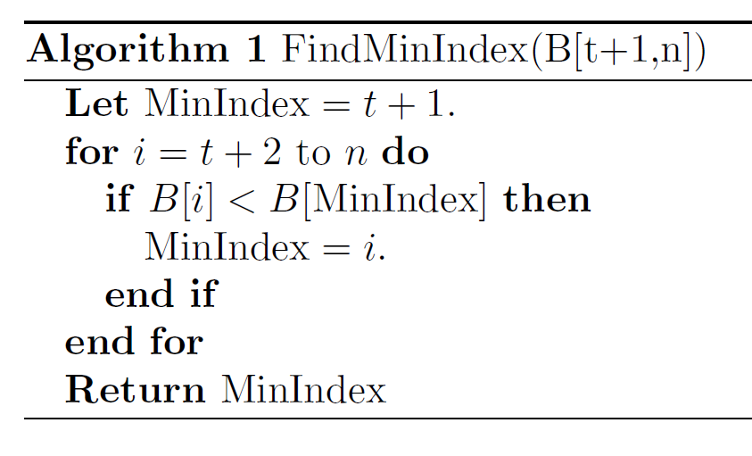
Our Informal Accounting
We’ll count basic operations (algebra, array assignment, etc) as constant time.
Not quite right --- as we’ll see, multiplication of large numbers should scale with the bit complexity --- but a good approximation for us.
We will analyze run-time by counting these operations.
Run time: $O(n−t)$

Slide 21
Asymptotic notation
For a pair of functions $f,g:ℕ→ℝ$, we write $f∈O(g\left(n\right))$ if there exist constants $c_{1},c_{2}$ such that for all $n≥c_{1}$, $f\left(n\right)≤c_{2}g(n)$.
For a pair of functions $f,g:ℕ→ℝ$, we write $f∈Ω(g\left(n\right))$ if there exist constants $c_{1},c_{2}$ such that for all $n≥c_{1}$, $f\left(n\right)≥c_{2}g(n)$.
For a pair of functions $f,g:ℕ→ℝ$, we write $f∈Θ(g\left(n\right))$ if $f∈O(g\left(n\right))$ and $f∈Ω(g\left(n\right))$.
We’ll often write $f\left(n\right)=O(g\left(n\right))$ because we are sloppy.

Slide 22
Asymptotic Notation (Basic Properties)
Multiplication by a Constant:
If $f\left(n\right)=O(g\left(n\right))$ then for any $c>0$, $c⋅f\left(n\right)=O(g\left(n\right))$
Transitivity:
If $f\left(n\right)=O(h\left(n\right))$ and $h\left(n\right)=O(g\left(n\right))$ then $f\left(n\right)=O(g\left(n\right))$
Symmetry
If $f\left(n\right)=O(g\left(n\right))$ then $g\left(n\right)=Ω(f\left(n\right))$
If $f\left(n\right)=Θ(g\left(n\right))$ then $g\left(n\right)=Θ(f\left(n\right))$
Dominant Terms:
If $f\left(n\right)=O\left(g\left(n\right)\right)$ and $d\left(n\right)=O(e\left(n\right))$ then $f\left(n\right)+d\left(n\right)=O\left(\max\left(g\left(n\right),e\left(n\right)\right)\right)$

Slide 23
See you next class!
“Problem Set 0” is out on Gradescope --- a survey about your background and expectations for the class.
No wrong answers, but must complete it.
Due 1 week from today (before next class)
Stay healthy and wear a mask.

