Slide 1
ESE532: System-on-a-Chip Architecture
Day 3: January 23, 2017
Parallelism Overview

Slide 2
Today
Parallelism in Tasks
Types of Parallelism
Compute Models
System Architectures

Slide 3
Message
Many useful models for parallelism
Help conceptualize
One-size does not fill all
But maybe 6—10 do?
Match to problem

Slide 4
Preclass 1
How do 6 people collaborate on sphere building?

Slide 5
Preclass 2
How do 12 people collaborate on sphere building?

Slide 6
Preclass 3
How do 6 people collaborate on building 3 spheres?
(alternate solution?)

Slide 7
In Class Exercise
Distribute 24 piece sets for building Red and Yellow Sphere
[if have more than 24 people, have pairs build a different model]
Follow instructions from slides to come

Slide 8
Step 1: Build half of L1

Slide 9
Step 2: Build half of L2

Slide 10
Step 3:
Pass half to builder with 2x2 plate

Slide 11
Step 4: Build L3

Slide 12
Step 5: Build L5 (ends)
(if have pieces)

Slide 13
Step 6:
Pass both “L5: ends” to builder with side

Slide 14
Step 7: half of L7
Install one side

Slide 15
Step 8:
Pass assembly to builder with unused side

Slide 16
Step 9: finish L7

Slide 17
Step 10:
Pass assemble to builder with unused side

Slide 18
Step 11: add 3rd side

Slide 19
Step 12:
Pass assemble to builder with unused side

Slide 20
Step 13: add final side

Slide 21
Finish
Check status of all builds

Slide 22
Types of Parallelism

Slide 23
Types of Parallelism
What kind of parallelism did we see for steps 1—3?

Slide 24
Types of Parallelism
What parallelism when some folks built different model?

Slide 25
Types of Parallelism
What could we build independently here?
Kind of parallelism?

Slide 26
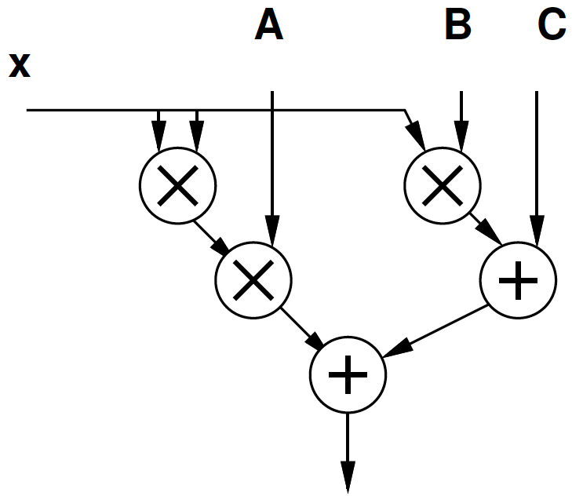
Type of Parallelism
Latency multiply = 1
Latency add = 1
(different Day2)
cycle | mpy | add
1 | B,x
2 | x,x | (Bx)+C
3 | A,x²
4 |  | Ax²+(Bx+C)
Kind of Parallelism?

Slide 27
Types of Parallelism
Data Level – Perform same computation on different data items
Thread or Task Level – Perform separable (perhaps heterogeneous) tasks independently
Instruction Level – Within a single sequential thread, perform multiple operations on each cycle.

Slide 28
Parallel Compute Models

Slide 29
Sequential Control Flow
Control flow
Program is a sequence of operations
Operation reads inputs and writes outputs into common store
One operation runs at a time
defines successor
Model of correctness is sequential execution
Examples
C (Java, …)
FSM / FA

Slide 30
Parallelism can be explicit
Sphere Build example Step 2
Coordinate data parallel operations
Multiply, add for quadratic equation
Coordinate ILP
cycle | mpy | add
1 | B,x
2 | x,x | (Bx)+C
3 | A,x²
4 |  | Ax²+(Bx+C)

Slide 31
Parallelism can be implicit
Sequential expression
Infer data dependencies
T1=x*x
T2=A*T1
T3=B*x
T4=T2+T3
Y=C+T4
Or
Y=A*x*x+B*x+C

Slide 32
Implicit Parallelism
d=(x1-x2)*(x1-x2) + (y1-y2)*(y1-y2)
What parallelism exists here?

Slide 33
Parallelism can be implicit
Sequential expression
Infer data dependencies
for (i=0;i<100;i++)
y[i]=A*x[i]*x[i]+B*x[i]+C
Why can these operations be performed in parallel?

Slide 34
Term: Operation
Operation – logic computation to be performed

Slide 35
Dataflow / Control Flow
Dataflow
Program is a graph of operations
Operation consumes tokens and produces tokens
All operations run concurrently
Control flow (e.g. C)
Program is a sequence of operations
Operation reads inputs and writes outputs into common store
One operation runs at a time
defines successor

Slide 36
Token
Data value with presence indication
May be conceptual
Only exist in high-level model
Not kept around at runtime
Or may be physically represented
One bit represents presence/absence of data

Slide 37
Token Examples?
What are familiar cases where data may come with presence tokens?
Network packets
Memory references from processor
Variable latency depending on cache presence
Start bit on serial communication

Slide 38
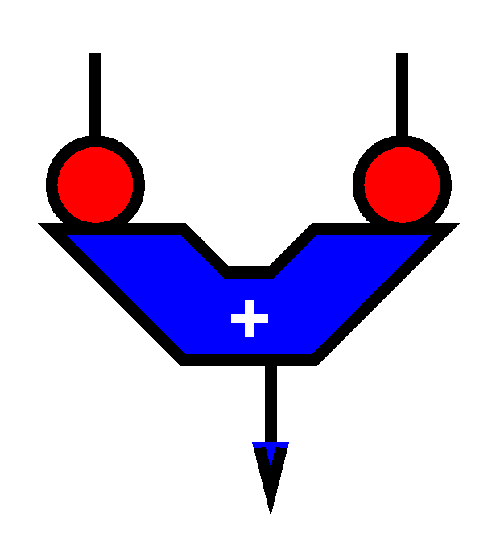
Operation
Takes in one or more inputs
Computes on the inputs
Produces results
Logically self-timed
“Fires” only when input set present
Signals availability of output

Slide 39
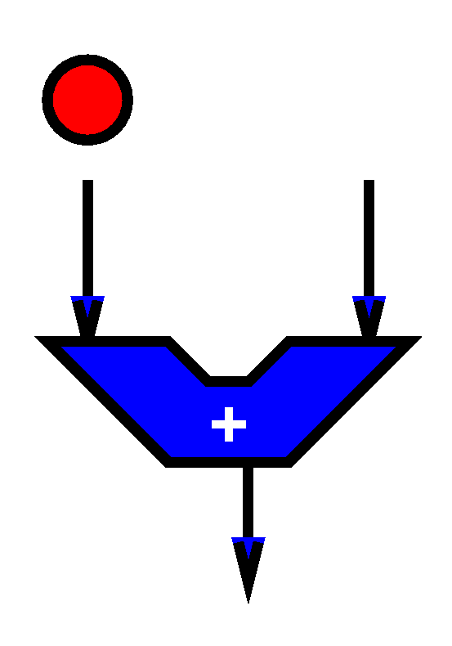
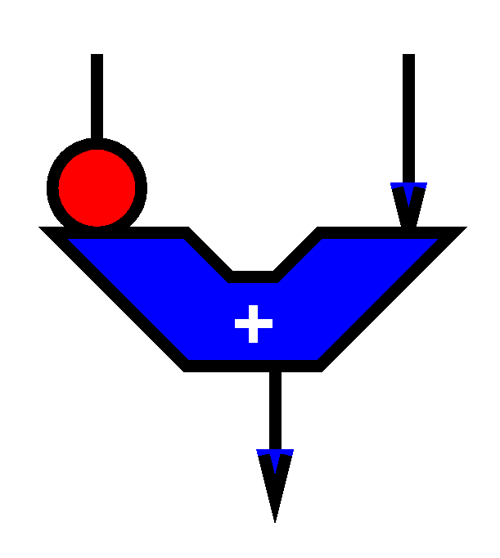
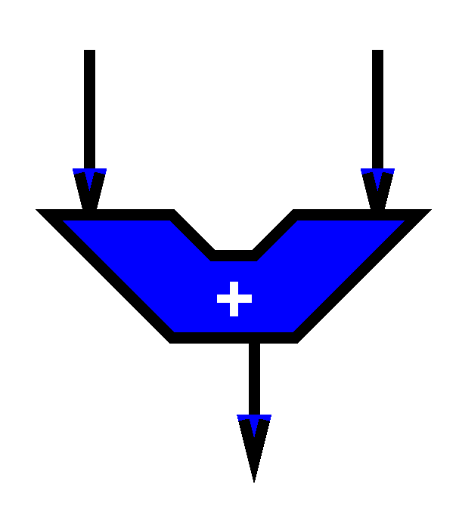
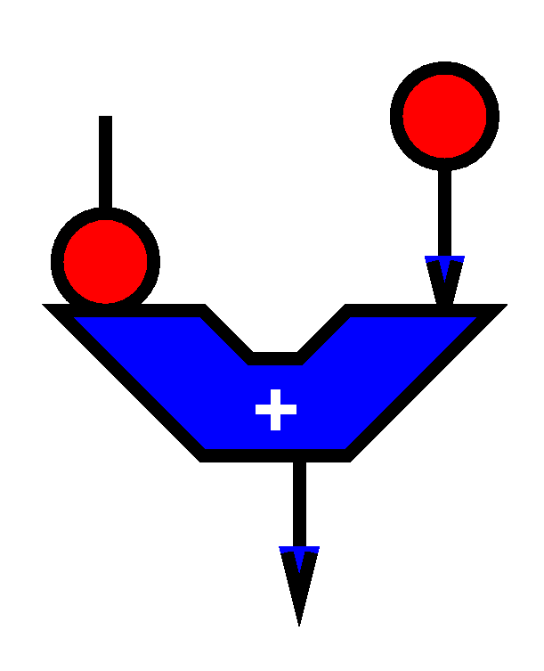
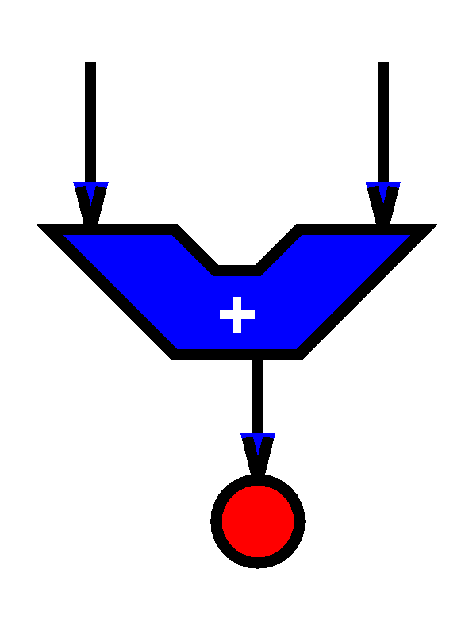

Slide 40
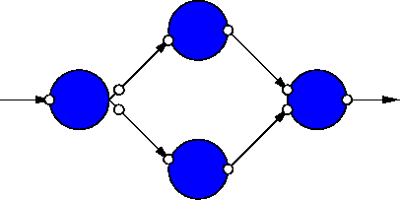
Dataflow Graph
Represents
computation sub-blocks
linkage
Abstractly
controlled by data presence

Slide 41
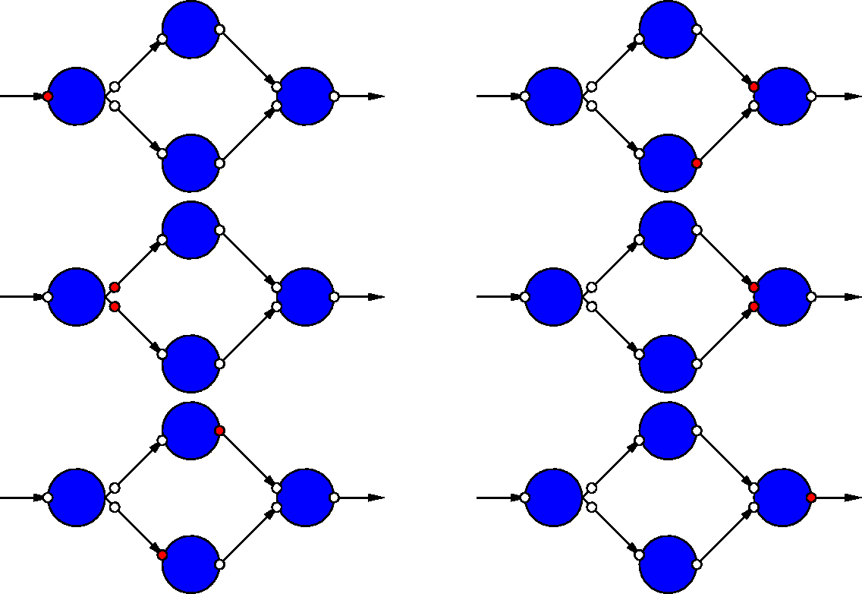
Dataflow Graph Example

Slide 42
Sequential / FSM
FSM is degenerate dataflow graph where there is exactly one token
S1
x not
present?
cycle | mpy | add | next
S1 | B,x |  | x-->S2, else S1
S2 | x,x | (Bx)+C | S3
S3 | A,x² |  | S4
S4 |  | Ax²+(Bx+C) | S1
S2
S3
S4

Slide 43
Sequential / FSM
FSM is degenerate dataflow graph where there is exactly one token
S1
cycle | mpy | add | next
S1 | B,x |  | x-->S2, else S1
S2 | x,x | (Bx)+C | S3
S3 | A,x² |  | S4
S4 |  | Ax²+(Bx+C) | S1
S2
S3
S4

Slide 44
Communicating Threads
Computation is a collection of sequential/control-flow “threads”
Threads may communicate
Through dataflow I/O
(Through shared variables)
View as hybrid or generalization
CSP – Communicating Sequential Processes → canonical model example

Slide 45
Video Decode
Audio
Sync to HDMI
Parse
Video
Why might need to synchronize to send to HDMI?

Slide 46
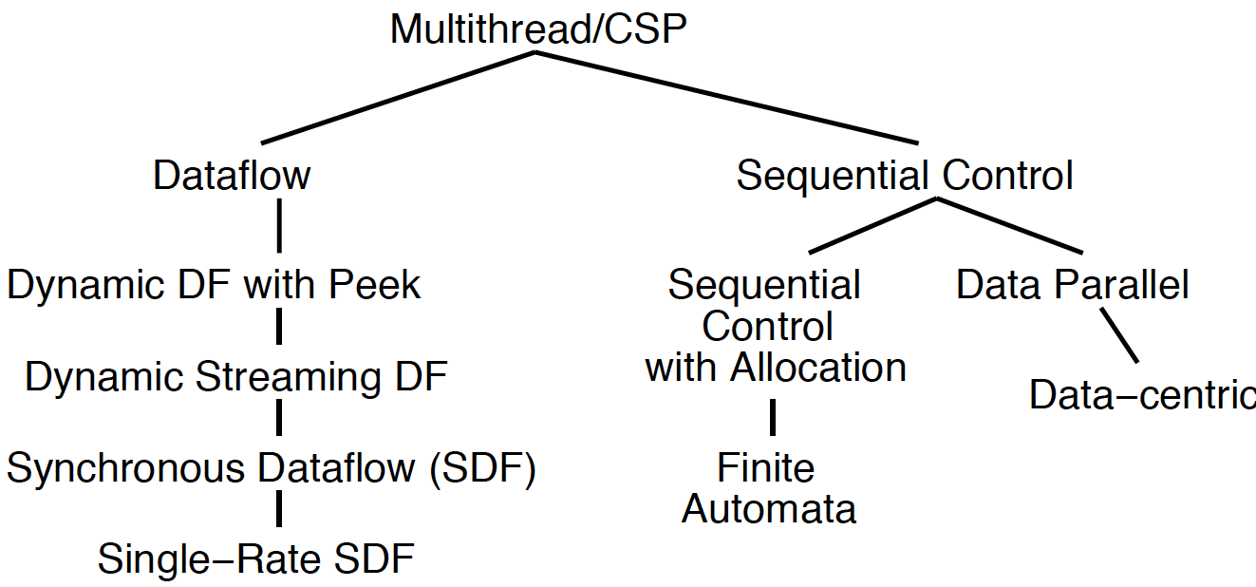
Compute Models

Slide 47
System Architectures

Slide 48
System Architecture Hypothesis
There are a small number of useful system architectures
These architectures
Give guidance for organizing resources
Make manageable
Allow share lessons between applications
Provide basis for scalability
Point toward efficient solutions

Slide 49
Unconstrained Model
Multithreaded programming (equivalently Communicating Sequential Processes)
Application is collection of threads
Communicate with each other
May or may not have shared memory
Programmer responsible for
Synchronization
Parallelism
Data layout
Communications…

Slide 50
Architectural Restrictions
Sequential Control
Data Parallel → all parallel processing does the same thing
Lock-Step → all parallel processing does different things at synchronized time (e.g. VLIW)
Bulk Synchronous → periodic barrier synchronization
Instruction Augmentation – control accelerators from seq. instruction stream

Slide 51
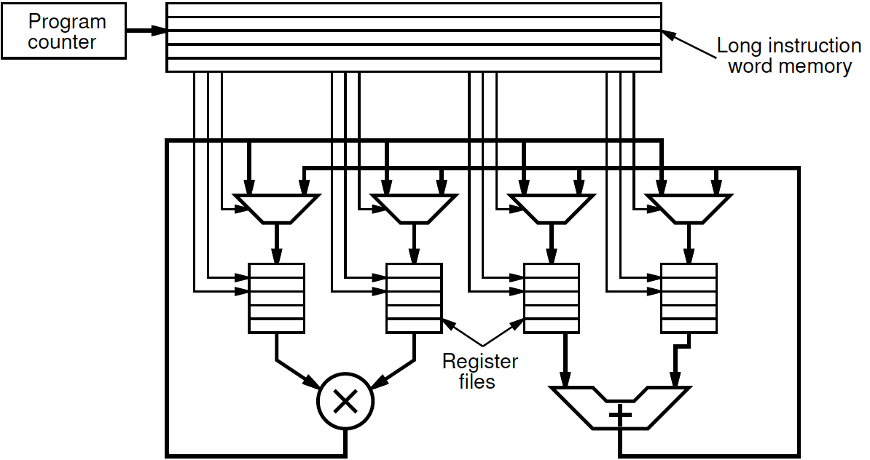
Very Long Instruction Word (VLIW)

Slide 52
Very Long Instruction Word (VLIW)
cycle | mpy | add
1 | B,x
2 | x,x | (Bx)+C
3 | A,x²
4 |  | Ax²+(Bx+C)

Slide 53
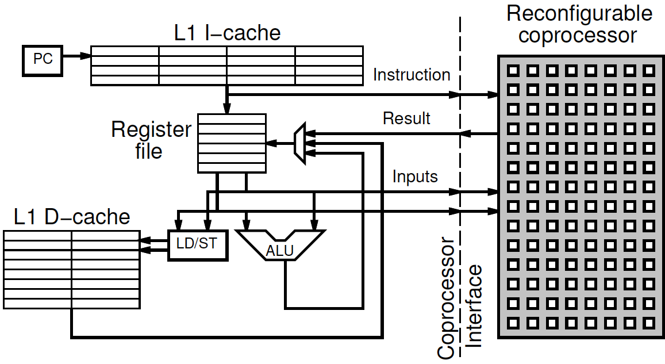
Instruction Augmentation Co-Processor

Slide 54
Architectural Restrictions (2)
Dataflow interactions
Allow multithreaded operation
Use data presence for synchronization
E.g.
Pipe-and-filter / Streaming Dataflow
Synchronous Dataflow (SDF)

Slide 55
Producer-Consumer Parallelism
Stock
predictions
encrypt
Can run concurrently
Just let consumer know when producer sending data

Slide 56
Pipeline Parallelism
ME
DCT
VQ
code
Can potentially all run in parallel
Like physical pipeline
Useful to think about stream of data between operators

Slide 57
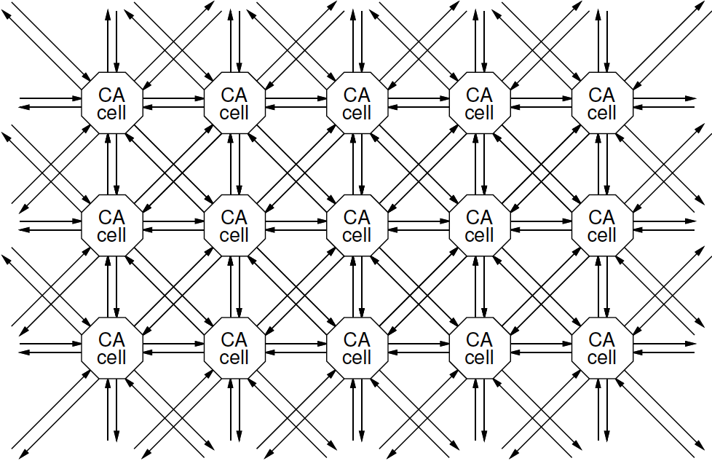
Architectural Restrictions (3)
Regular Communication Patterns
Systolic
Cellular Automata → regular grid of homogeneous FSMs

Slide 58
Architectural Restrictions (4)
Memory/Data Centric
Computation is collection of objects in memory
Each object triggered by input changes
Compute and potentially trigger other objects
E.g.
Repository models
GraphStep
App: network flow, routing…

Slide 59
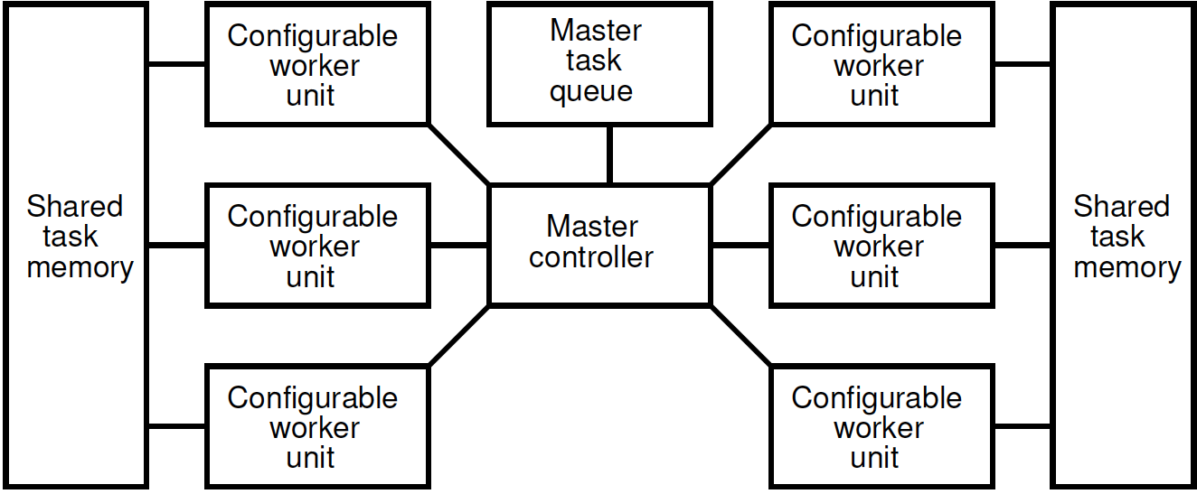
Work Farm
Central controller farms out work

Slide 60
System Architecture Taxonomy

Slide 61
System Architecture Taxonomy
Further down the hierarchy
More restricted the model
More guidance provided
More efficient potential implementation
More amenable to analysis
→ tools and optimizations
Restrictions provide power

Slide 62
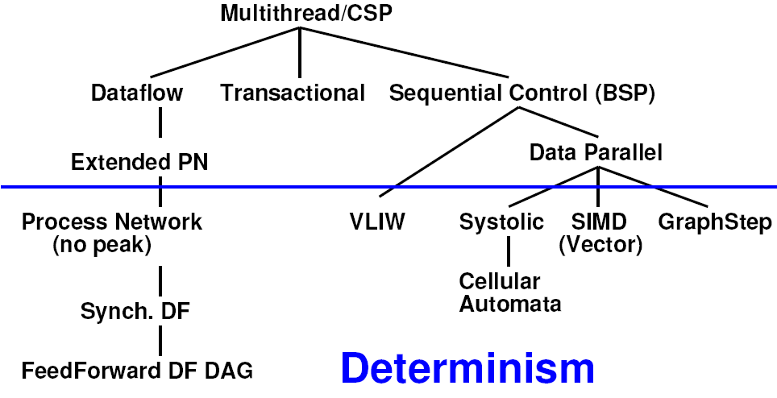
System Architecture Taxonomy
Further down the hierarchy
More restricted the model
More guidance provided
More efficient potential implementation
More amenable to analysis
→ tools and optimizations
Restrictions provide power

Slide 63
Value of Multiple Architectures
When you have a big enough hammer, everything looks like a nail.
Many stuck on single model
Try to make all problems look like their nail
Value to diversity / heterogeneity
One size does not fit all

Slide 64
System Architecture Hypothesis
There are a small number of useful system architectures
These architectures
Give guidance for organizing resources
Make manageable
Allow share lessons between applications
Provide basis for scalability
Point toward efficient solutions

Slide 65
System Architectures

Slide 66
Model → Architecture not 1:1

Slide 67
Big Ideas
Many parallel compute models
Sequential, Dataflow, CSP
Useful System Architectures
Streaming Dataflow, VLIW, co-processor, work farm, SIMD, Vector, CA, FSMD, …
Find natural parallelism in problem
Mix-and-match

Slide 68
Admin
HW1 FAQ
roundup of problems and solutions
Reading for Day 4 on web
Talk on Thursday by Ed Lee (UCB)
3pm in Wu and Chen
HW2 due Friday

